Slide 1
Insert
Logo
School Name
Insert
Class
Photo

Slide 2
Name:
Birthday:
Eye Colour:
Hair Colour:
Height:
Favourite Colour
Favourite Animal
If I could have a superpower, I’d….
Favourite School Subject
Best place I’ve ever been to…
Dream country to visit…
If I could travel back in time, I’d go to…
My dream job is…

Slide 3
Who are the people you class as family and friends?

Slide 4
Life is a journey! Think back through your time at primary school and write down your key memories or events that have shaped you to become the amazing person you are…

Slide 5
Here is a look back at each year of you primary school life. What stands out? What can you remember? Who did you meet and where did you visit?
Nursery
Reception
Year 2
Year 1
Year 3
Year 4
Year 6
Year 5

Slide 6
What have been your biggest achievements at primary school? Who help you to achieve them?
What have you learnt at primary school that will prepare you for your future? Think about more than just curriculum lessons, what about lessons about life…

Slide 7
What are some of your favourite memories of your years at primary school?

Slide 8
Which staff members do you want to remember forever and what will you remember about them? What did they teach you and how did they make you feel?

Slide 10
School Name
School Address
School Telephone Number
Name of the Head Teacher
School Starts at
School Finishes at
I will get to school by
How long will it take you to get to school?
What time will you have to leave home?

Slide 11
I am most looking forward to…
I feel a bit nervous about…
I would like to know…
Some things that could help me are…
Some things that will be different from primary school are…
In one word I feel…

Slide 12
Which 6 subjects are you most looking forward to from the list below and why…
Maths
English
Science
Geography
History
Computing
PE
Art
Music
Drama
Dance
Religion
Textiles
Cookery
Woodwork
Languages
Careers
Wellbeing

Slide 13
At high school, you will probably have a timetable which looks a bit like this. The one below is our timetable which we have been using for most of this year. The only difference is your high school one may have different subjects, teachers and rooms on.
 | Monday | Tuesday | Wednesday | Thursday | Friday
Breakfast Club 08:00-08:45
Period 1 08:45-9:30 | ASSEMBLY | ASSEMBLY | GUIDED READING | ASSEMBLY | ASSEMBLY
Period 2 09:30-10:30 | MATHS | MATHS | MATHS | MATHS | MATHS
BREAK 10:30-10:45
Period 3 10:45-11:15 | SHARED READING | SHARED READING | SHARED READING | SHARED READING | SHARED READING
Period 4 11:15-12:20 | WRITING | WRITING | WRITING | WRITING | WRITING
LUNCH 12:20-13:20
Period 5 13:20-14:15 | ART/DT | HISTORY | COMPUTING | PSHE | SCIENCE
Period 6 14:15-15:15 | PSHE | RE | GYM | GAMES | PSHE
Extra-Curricular 15:15-16:00 |  | CREATIVE CLUB |  | FOOTBALL CLUB
What clubs are you looking forward to joining at your new school?

Slide 14
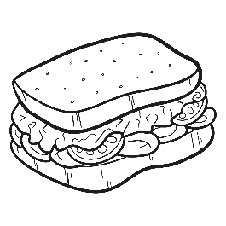
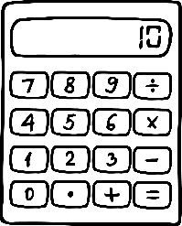
You will need to take your own equipment to high school. You will probably store this in your locker for the day and
may need to go back to collect it between lessons. Which of the equipment below do you already have ready to take to your new school and which might you need to buy? Do you think school will provide you with any of the them?

Slide 15
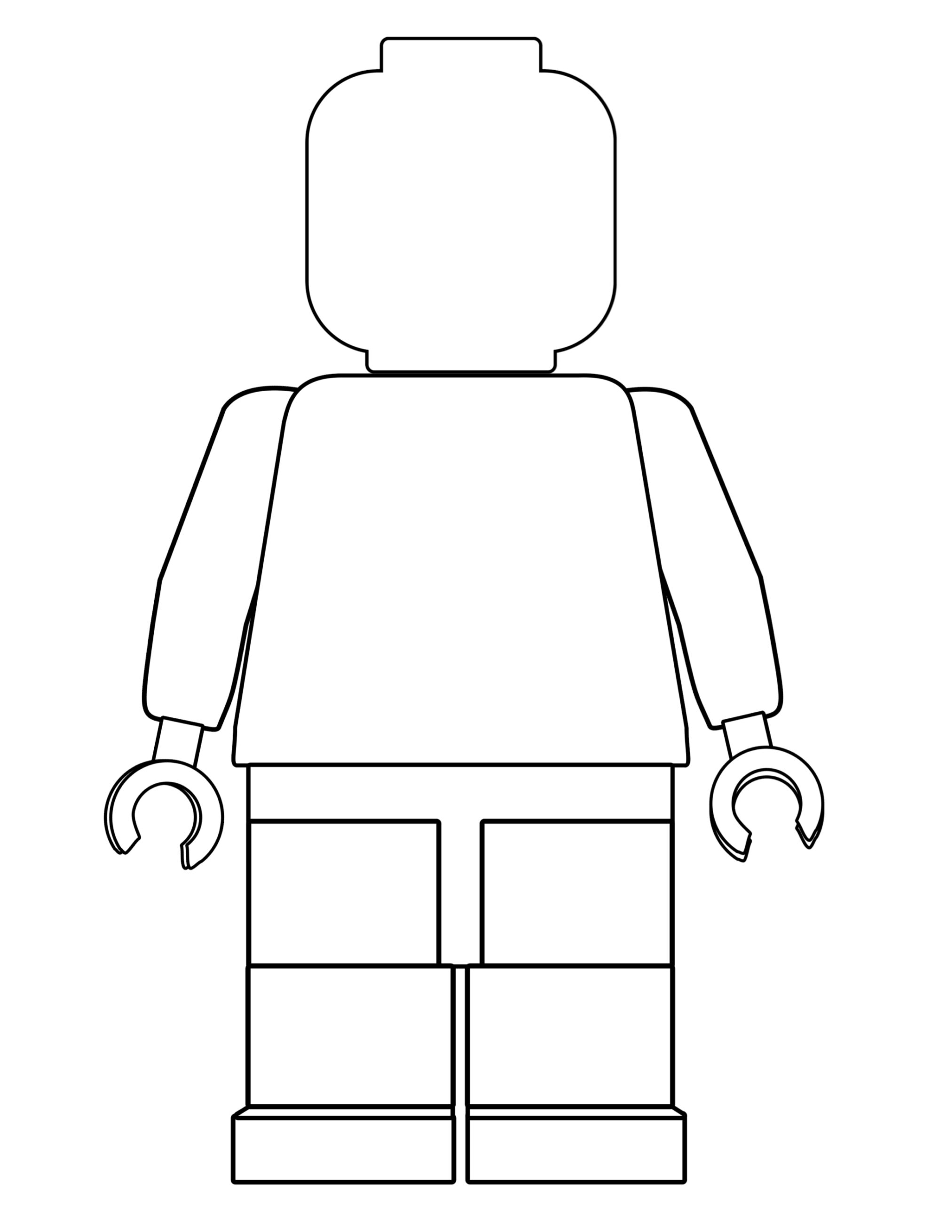
One of the different things about moving to secondary school is the change in what you will wear. Use the school website to draw and label the school uniform you will wear onto the Lego figure
Why is wearing the correct school uniform important?
………………………………………………………………………………………………………………………………………………………………………………………………………………………………………………………………………………………………………………………………………………………………………………………………………………

Slide 16
Getting to your secondary school safely is just as important as being there. In the box below, draw the route you are going to take to school (whether that’s walking, cycling, driving or by bus). Identify spots where there could be hazards (e.g. busy roads) and explain how you will manage this safely!

Slide 17
There will be high expectations of your behaviour at high school, just like we have at our school. Which of the expectations below do you think are the most important? Are any of these different to the expectations we have?
Turning up on time to lessons
Working successfully as part of a team
Being respectful of other peoples beliefs
Having your shirt tucked in neatly
Contributing to lessons
High level of respect shown to all
Saying good morning to people as you pass
Supporting others
Holding the door open for a teacher
Having a pen, pencil and ruler in lesson
Consistent punctuality over the whole year
Helping with Breakfast Club
Turning up on time to lessons
Acting as an ambassador role
Going above and beyond with your work
Staying calm if something goes wrong
Being respectful to other staff and students
Sitting with someone who is alone at lunch
Apologising if you have done something hurtful
Turning up on time to lessons
Discussing issues with a teacher
Remembering your homework
Giving someone a compliment
Asking for help when needed
Are there any you would add?

Slide 18
When you go to Secondary School, you will learn a huge number of new skills, and improve skills you have practiced in Primary School. From the suggestions below, colour in at least 10 new skills or things you’d like to build on in your years at Secondary School. Can you add any of your own to the empty boxes?
Be in a school play or production | Speak another language | Represent your school in competition
Learn to play a musical instrument | Volunteer in the local community | Travel to another country
Play for a school team | Learn how to survive in the wild | Take care of the school garden
Learn how to manage money | Taste food from another country | Walk the school dog
Cook a new meal from scratch | Read new books | Take part in a fancy dress day
Create a piece of art | Raise money for charity | Become Head Boy or Girl
Learn how to read a map | Join an after school club | Learn to dance
Use computers to create your own website | Learn First Aid | Improve your singing
Make new friends from other schools | Work as part of a team | Try camping

Slide 19
After secondary school, you can move onto college or an apprenticeship and then to University or into a job! It’s normal not to know what you want to do yet but this is a chance for you to have a think about your dream jobs!

Slide 20
Last six hours of primary school
Goodbye is getting near
The sums and sentences all done
The full stop day is here
Last four hours of primary school
Surrounded by a class
Who'll scatter soon and not return
when summer’s days have passed
Last two hours of primary school
The clock hands blur and skid
Signing shirts, remembering
the coolest things we did
Last half hour of primary school
The final moments we all dread
We cannot sing - us Year Six kings
The crown slips from our heads
Last five hours of primary school
Where everything's before
The aims and games and crazes
no one’s crazy for no more
Last three hours of primary school
One final lunchtime play
Instead of chasing friends we try
to chase and catch the day
Last one hour of primary school
With Miss who understood
And helped me see I could achieve
‘cos she believed I could
Last ever second of primary school
The full stop rings in our ears
But a thousand chapters left to write
We must vacate our childhood site
For time moves on and time is right -
To leave our wonder years
Insert
Class
Photo

