Slide 1
CIRCLES
Part of a CIRCLE
Primary 6
Maths
By: Jinky Dabon

Slide 2
CENTRE
The centre of a circle is a fixed point in the middle of the circle.
The distance from the centre of a circle to any point on the circumference of the circle is always the same.

Slide 3
Circle M
M
The letter that represents the centre of a circle can be used to name circle. For example, the circle in the above diagram can be called Circle M.

Slide 4
CIRCUMFERENCE
The circumference of a circle is the edge or perimeter of the circle.

Slide 5
RADIUS
The radius of a circle is a straight line that has one endpoint on the centre of the circle and the other endpoint on the circumference of the circle.

Slide 6
DIAMETER
The diameter of a circle is a straight line that passes through the centre of the circle and has both endpoints on the circumference of the circle.
The diameter of a circle is twice as long as the radius of the circle.

Slide 7
CHORD
The chord of a circle is a straight line that has both endpoints on the circumference of the circle.

Slide 8
PARTS OF A CIRCLE
CIRCUMFERENCE
CENTRE
M
Circle M
DIAMETER
RADIUS
CHORD

Slide 9
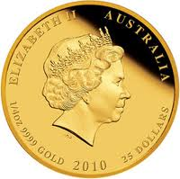
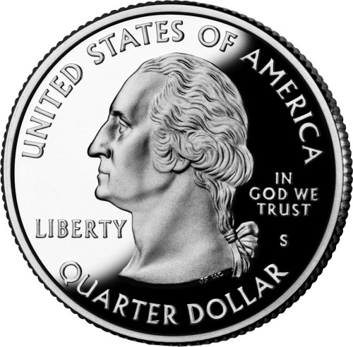
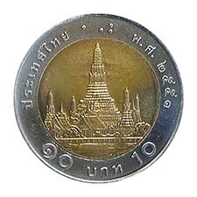
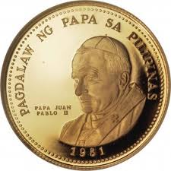
Things that are shaped like a circle....

