Slide 1
PSHE and Citizenship
Health and Wellbeing | Social Media and Digital Wellbeing
PSHE and Citizenship | Age 7-9 | Home Learning | Health and Wellbeing | Social Media and Digital Wellbeing
Notes:
Disclaimer:
This resource is provided for informational or educational purposes only. It is intended to offer general first aid advice and is not a substitute for professional medical advice specific to your circumstances.
We do not warrant that the information provided will meet your or your students’ specific health or medical requirements. It is up to you to contact a suitably qualified health professional if you are concerned about your health and it is up to you to advise your students to contact a suitably qualified health professional if they are concerned about their health.
You and your students are encouraged to act within the guidance provided by this resource and we do not accept responsibility for you or your students failing to do so.

Slide 3
Aim
I know how to look after my physical wellbeing and mental health when using the Internet.
Success Criteria
I know how to protect my physical wellbeing when online.
I know how to protect my mental health when online.
I can identify online risks, including social media risks.
I know what to do about cyberbullying.
This resource is fully in line with the Learning Outcomes and Core Themes outlined in the PSHE Association’s Programme of Study.

Slide 4
The Big Questions

Slide 5
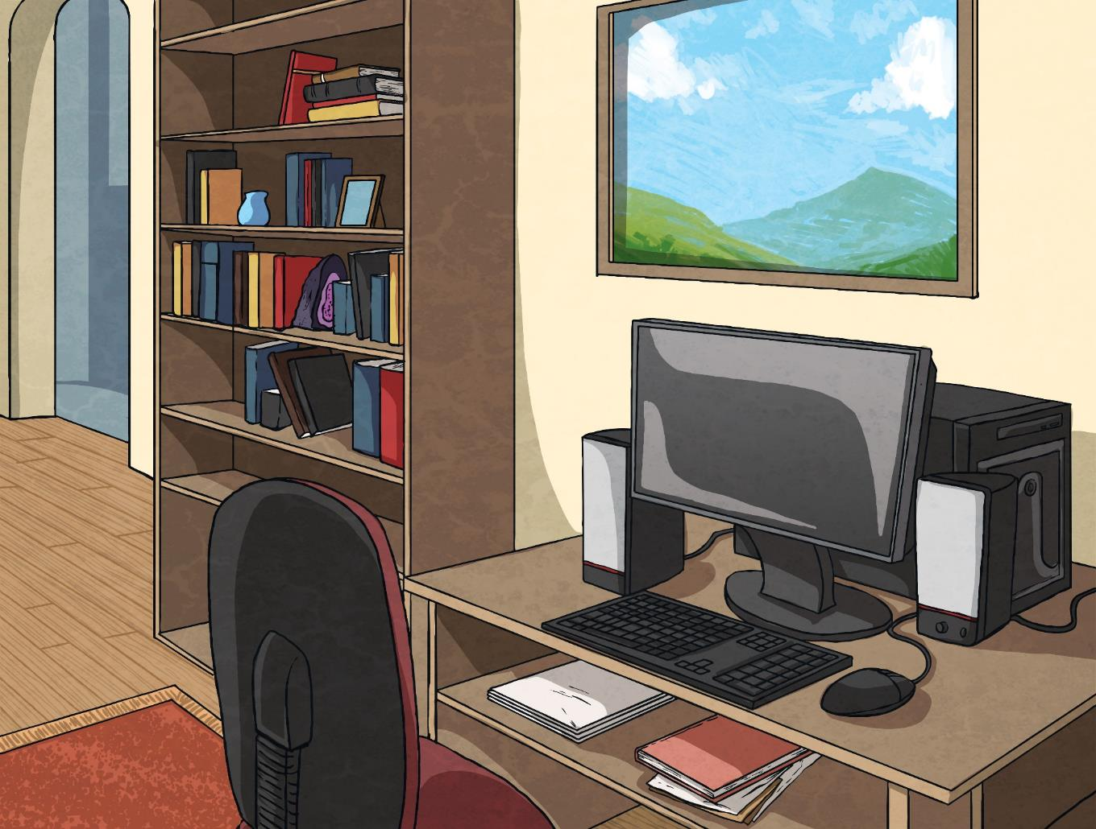
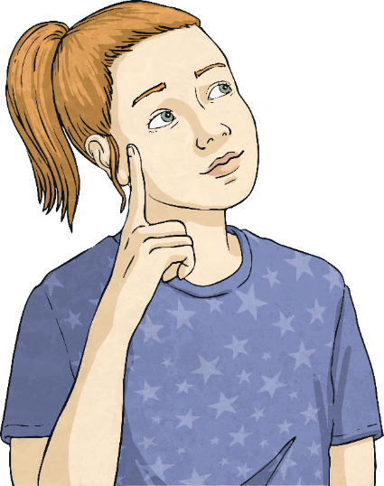
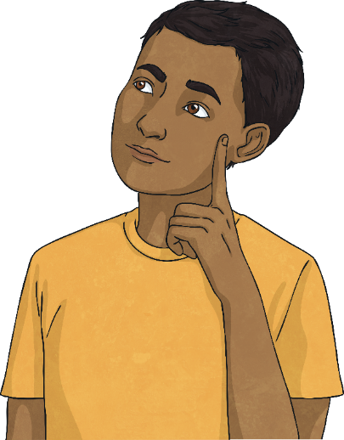
What is cyberbullying and how does it affect people?
What is social media and what are the risks?
How can I protect my physical wellbeing and mental health when online?

Slide 6
Reconnecting

Slide 7
What Does It Mean?
Today, we are going to see and use lots of specific vocabulary. Do you think you know what these words or phrases mean?
cyberbullying
Cyberbullying
Sending unkind or threatening messages via electronic devices.
Device
A piece of electronic equipment.
Gaming
The action of playing video games.
Online
Connecting to the Internet or other devices, such as a computer or a printer.
Personal Information
Specific information, such as your name, address, age and the school you go to.
Screen Time
The amount of time spent looking at a phone, tablet, computer or television screen.
Smartphone
A mobile phone that can do many of the things that a computer can do.
Social Media
Websites and apps that let you share content, such as messages, photos and videos.
Tablet
A small, mobile computer with a touchscreen.
device
gaming
online
personal information
screen time
smartphone
social media
tablet

Slide 8
Exploring

Slide 9
How We Use Social Media
Using social media sites and apps can be a great way to keep in contact with friends and family.
Which social media sites or apps have you heard of?
Have you communicated with other people over the Internet?
Many people have accounts on social media sites that allow them to chat with others, share photos, send videos and comment on other people’s posts.

Slide 10
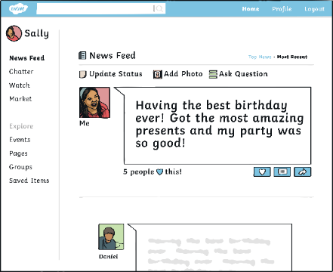
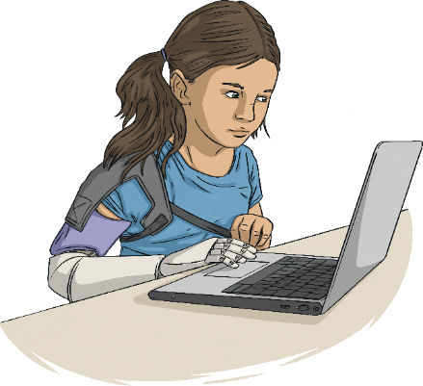
How We Use Social Media
Did you know…
18% of eight to eleven year olds have a social media profile?
35% of children aged eight to eleven have a smartphone?
47% of children aged between eight and eleven own a tablet?
93% of eight to eleven year olds go online for over 13 hours a week?
Did any of these surprise you? Do you think you fall into any of these groups?

Slide 11
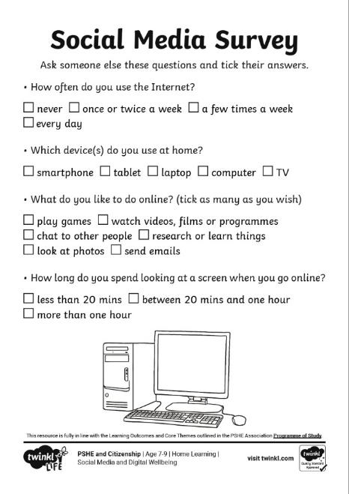
How We Use Social Media
Let’s see how we fit in with this data.
See if you can answer the questions on the Social Media Survey.

Slide 12
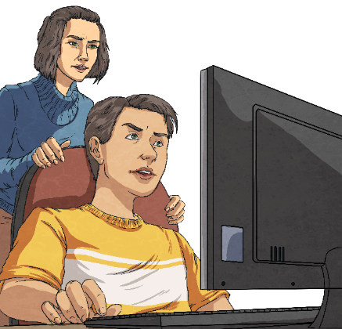
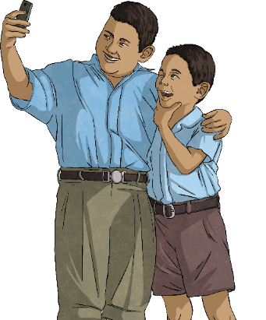
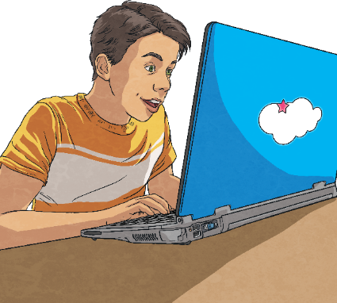
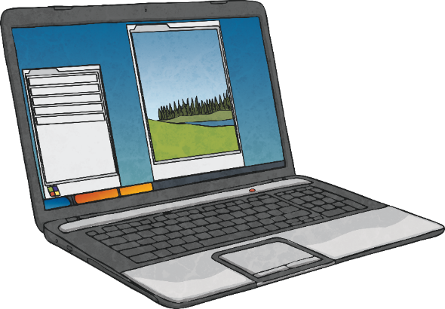
How We Use Social Media
We are all different and like doing different things.
Other families might have different rules about using the Internet.
Other people might have different devices at home.
Some people may not have a television, computer, tablet or phone.
Some people might use social media a lot, while others never use it.

Slide 13
Social Media and Digital Wellbeing
Just like in real life, we need to think about our physical and mental wellbeing when we are online.
Social media can be great but there are some risks to be aware of.
Spending too much time using screens.
Copying things we see online.
Chatting to strangers.
Giving away personal information.
Seeing things that upset us.
Online bullying.
Worrying too much about what others think about us.
Sharing photos or videos of ourselves or others.
Feeling like we might be missing out on group chats or other activities.

Slide 14
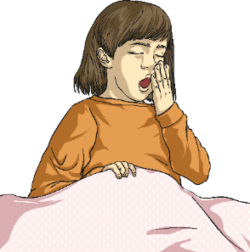
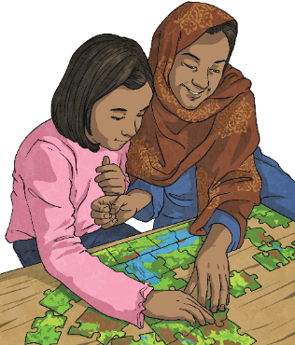
Social Media and Digital Wellbeing
Whenever, or however, we use social media, we all need to make sure we are safe and happy online.
There are things we can all do to protect our physical wellbeing, such as limiting screen time and not using devices just before bedtime.
Let’s take a look at some great advice when it comes to staying safe and happy online using various types of social media.
There are also things we can all do to protect our mental wellbeing, such as making sure we still spend time connecting with others in the real world and telling a trusted adult if we see something online that upsets us.

Slide 15
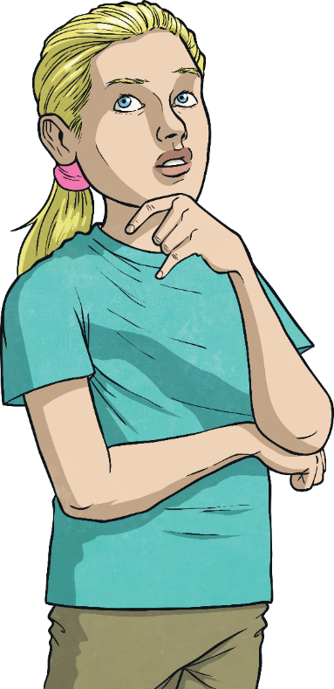
Social Media: Staying Safe and Happy
Do you agree or disagree with the following statements?
Sitting in front of a screen for a long time might mean we are missing out on other activities that are good for our wellbeing, such as spending time in the fresh air, playing with friends, spending time with our family and pets or getting creative.
Using a device at bedtime will make getting to sleep more difficult. Sleep is important for our general wellbeing.
We might get eye strain or headaches which affects our wellbeing.
Too much screen time can be bad for our physical health.

Slide 16
Social Media: Staying Safe and Happy
Did you know…?
Some videos challenge us to try things (a bit like a dare) but this is never a good idea as you could get hurt.
Some social sites contain a lot of videos. Some videos might be of cute animals while others might be of people doing funny things.
There are some videos on the Internet of people doing silly, risky or dangerous things and we should never copy these.

Slide 17
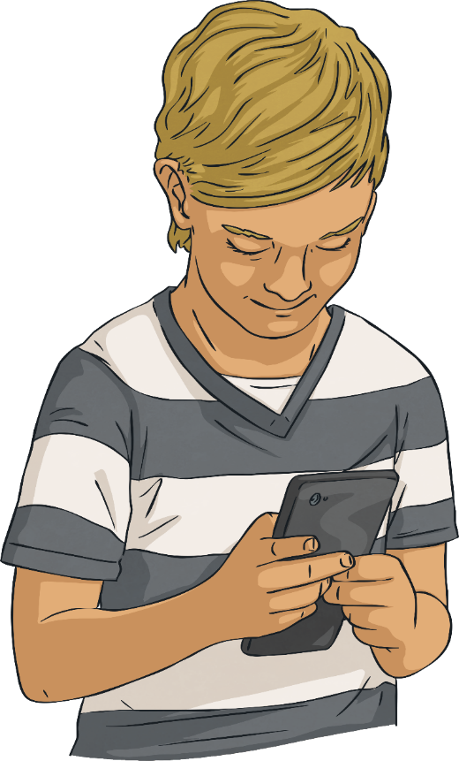
Social Media: Staying Safe and Happy
Many people can become hooked on social media, wanting to spend more and more time using it.
This isn’t good for our mental or emotional wellbeing.
They can start to place a lot of importance on what others say about their photos, videos, posts or comments.
It’s impossible to measure how popular or well-liked we are by others’ online behaviour and comments can be misinterpreted online.
Some people worry a lot about what others think of them and they become desperate to be liked online.

Slide 18
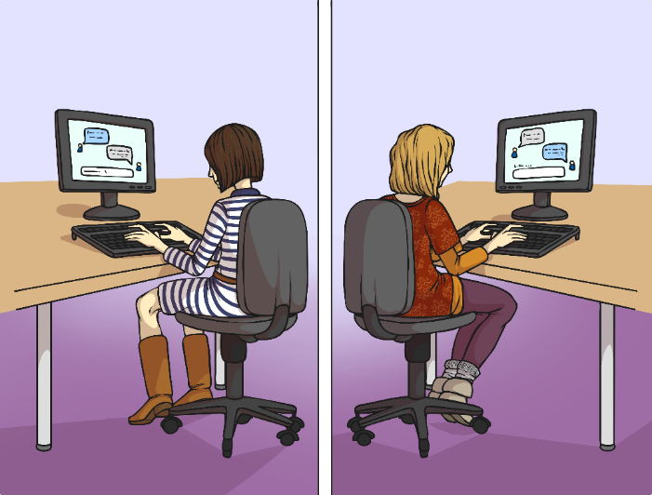
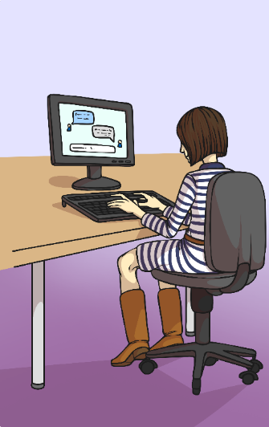
Social Media: Staying Safe and Happy
Have you ever considered…?
?
For example, you might be playing a game online and start chatting to someone who says they are your age and says they like the same things that you like.
When we chat to other people online who we don’t know in real life, we can’t be sure they are who they say they are.
But that person could be lying.

Slide 19
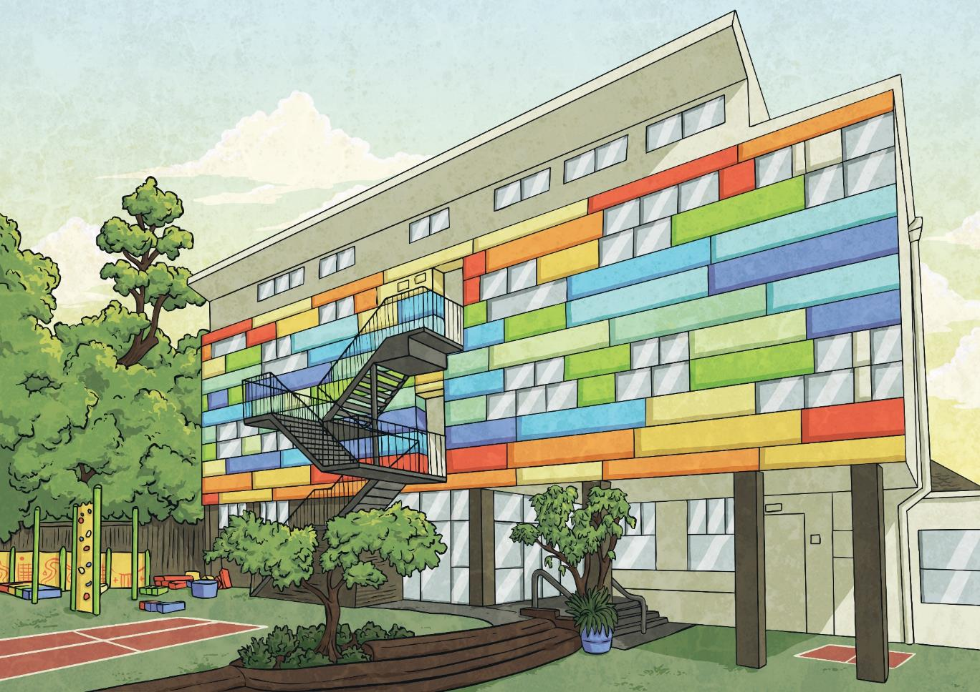
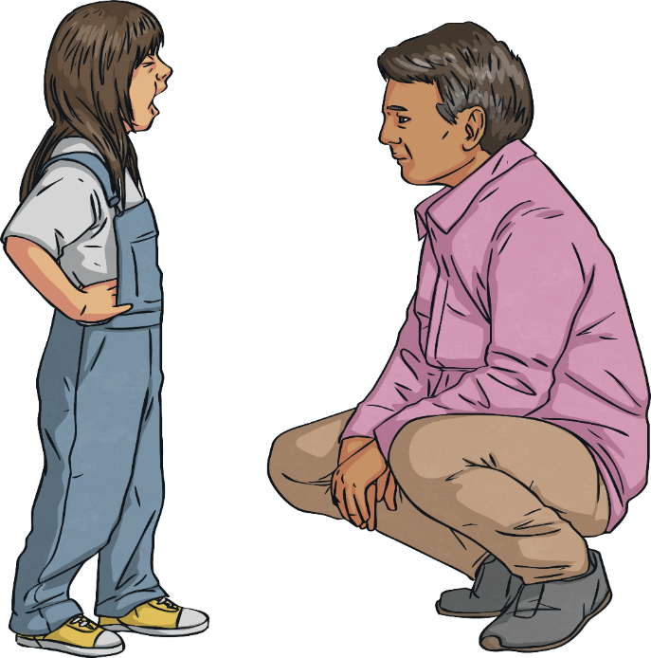
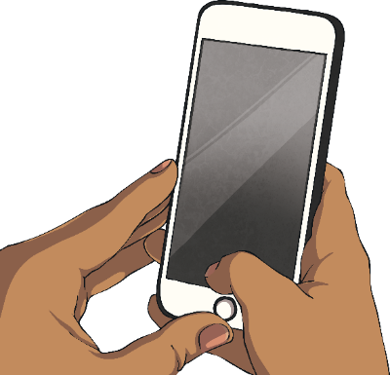
Social Media: Staying Safe and Happy
If anyone ever approaches you saying they know you or a member of your family, but you don’t know them, run away and tell a trusted adult immediately.
We need to remember what our personal information is and make sure we don’t share that online for everyone to see.
If a stranger sends you messages online, don’t reply and don’t delete them. Tell a parent or a teacher and show them the messages. They can then block the person or report them to the police, if necessary.
We should never give our full name, our address or the school we go to. We also do not need to post pictures or videos of ourselves with our names.

Slide 20
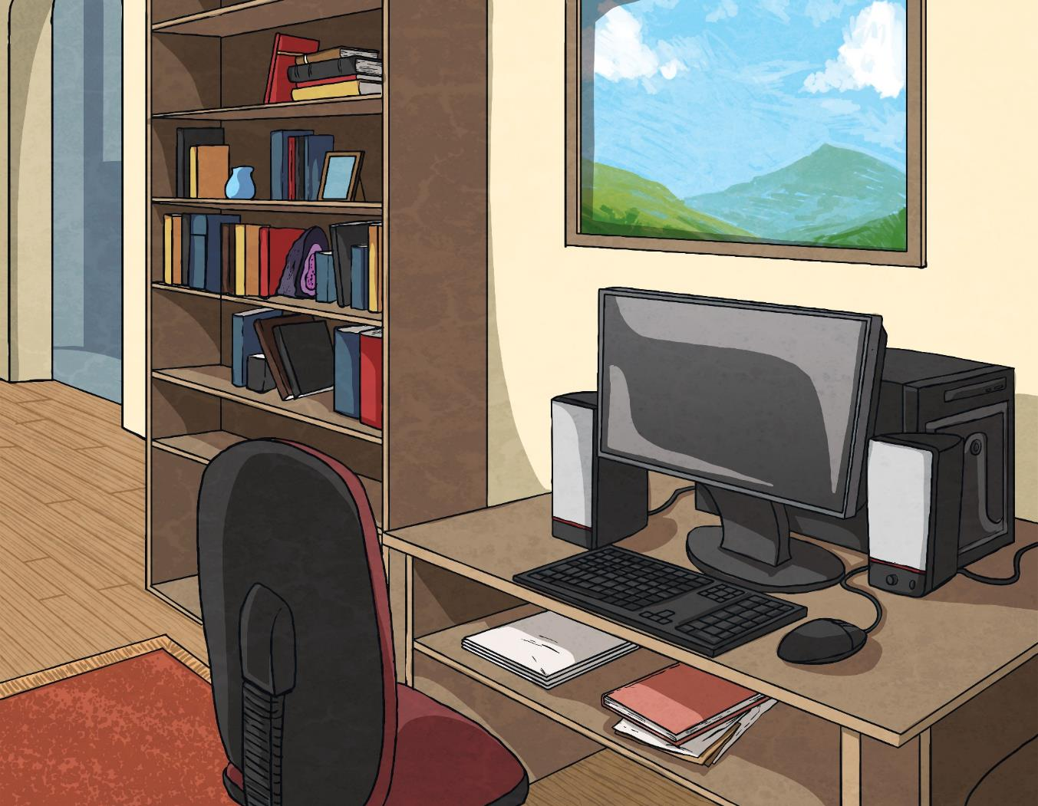
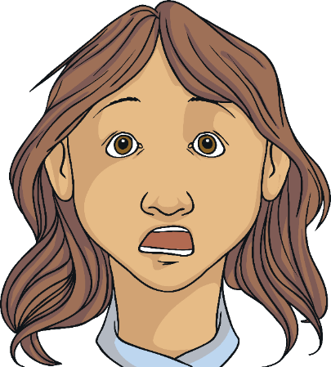
Social Media: Staying Safe and Happy
Most social media sites have age restrictions, meaning that anyone under 13 cannot have an account.
Some things on social media, and on the Internet in general, are not meant for children.
Schools have things called filters on their devices so that children are protected from seeing things they shouldn’t. Parents can put these filters on at home, too.
If you ever see something online that upsets you, frightens you or makes you feel uncomfortable, tell a trusted adult straight away. They can see what it was, then block that site.

Slide 21
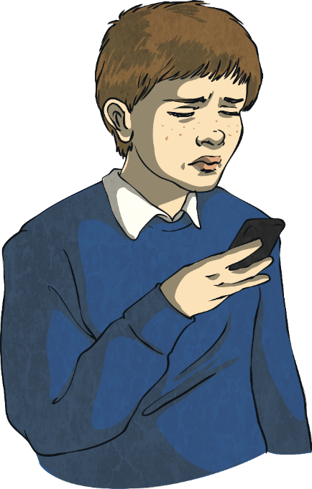
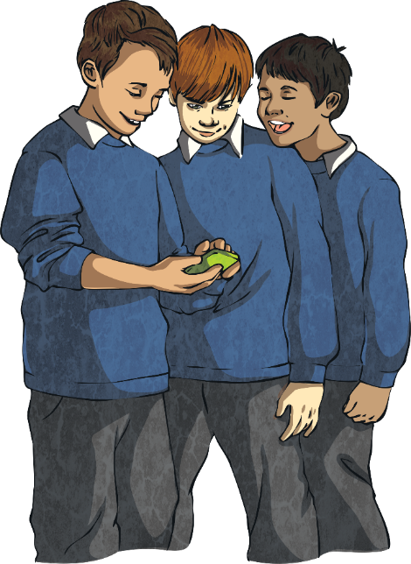
Social Media: Staying Safe and Happy
Cyberbullying means being unkind to someone through text, email, online gaming or social media sites.
Bullying is a serious issue and it affects many people’s wellbeing.
If you ever receive messages that upset you, threaten you or scare you, you must report it.
Don’t reply but don’t delete the messages. Tell a trusted adult so that they can read the messages and sort out the problem before it gets worse.
It takes courage to report a bully but it’s the only way they will be stopped.

Slide 22
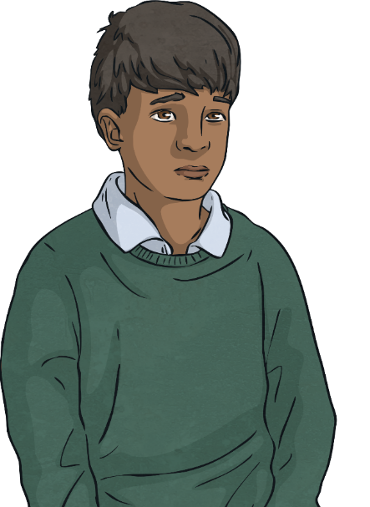
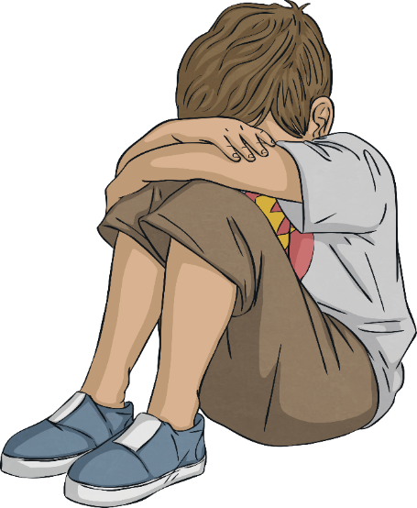
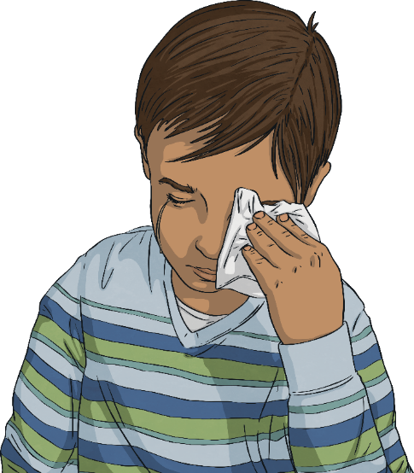
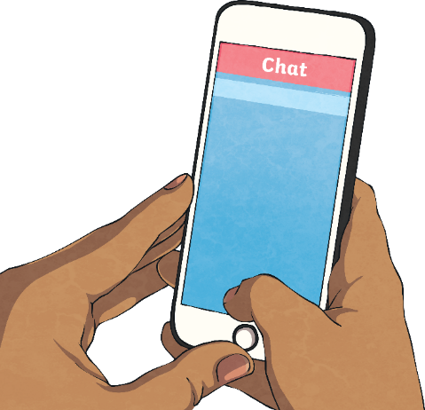
Be Kind Online
Some people don’t realise how upsetting it can be to be bullied online.
Children who have experienced cyberbullying say it makes them feel lonely, sad and frightened.
Some children receiving nasty messages might want to stop coming to school.
They might believe what the bullies are saying and think the problem is with them but it isn’t – it’s the bullies who have the problem.
Others might start retaliating – that means doing the same thing back to the bullies. This doesn’t address the problem, it makes things worse.

Slide 23
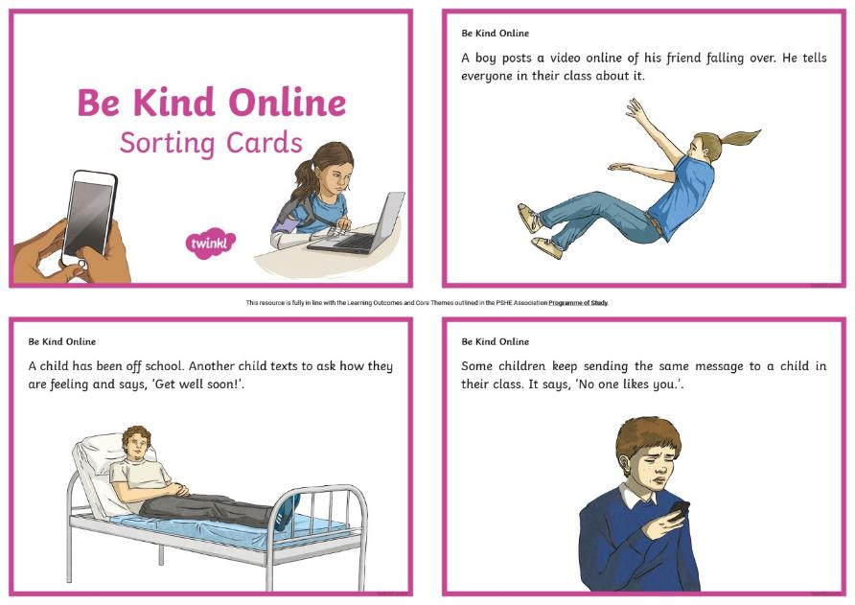
Be Kind Online
Take a look at the Be Kind Online Cards and sort them into those that are kind and those that are not.

Slide 24
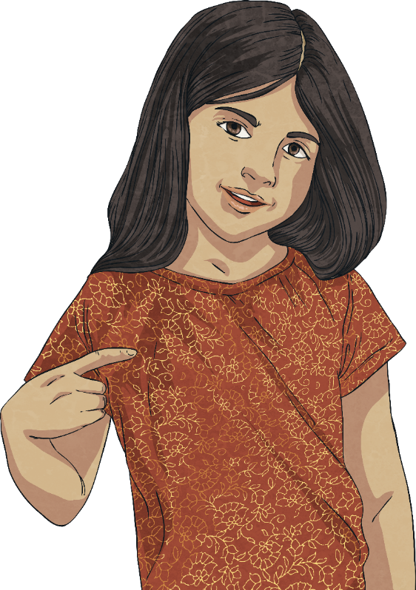
Be Kind Online
How did you do with sorting the cards?
We can all be kind online.
Show respect to others.
Think to yourself before you send a message or post something online, ‘Would I like this if it happened to me?’.
If you, or someone you know, is being bullied online, report it to someone and get help.

Slide 25
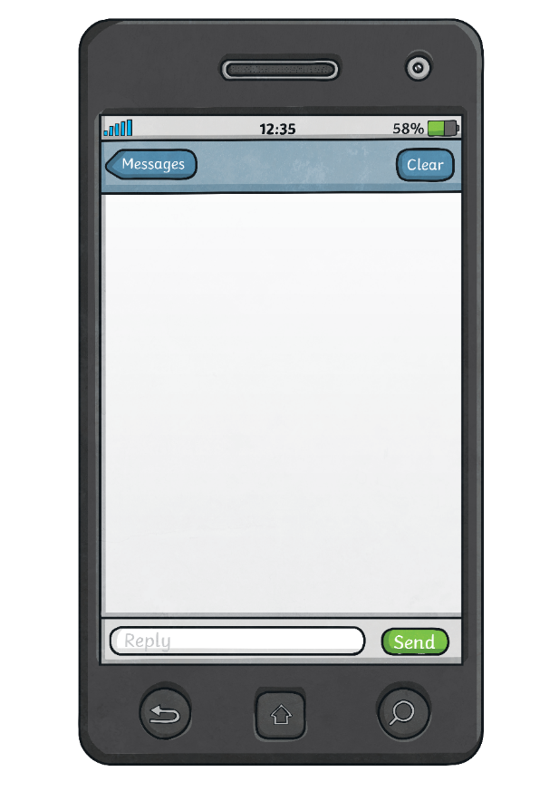
Consolidating
Reflecting

Slide 26
Consolidating

Slide 27
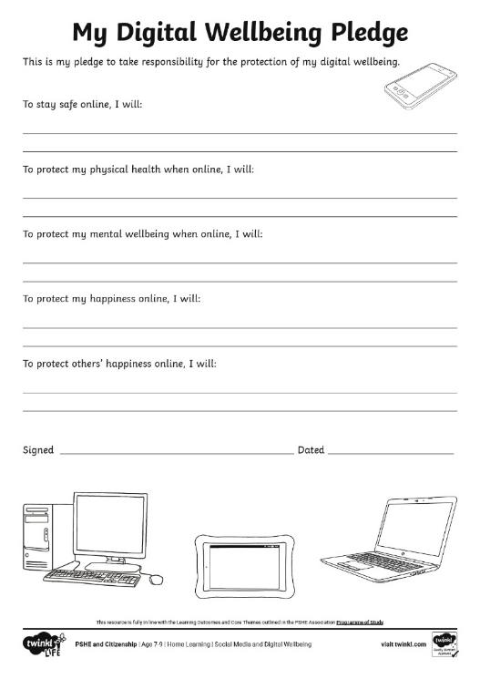
My Digital Wellbeing Pledge
We can’t control the behaviour of others online but we can control our own behaviour.
We are in control of what we do online, how we respond to others online and what we do if we see something that upsets us.
Fill in the My Digital Wellbeing Pledge by stating the things that you are going to make sure you do to stay safe and happy online.

Slide 28
Reflecting

Slide 29
Today, I Learnt…
We have learnt a lot today about social media and the risks we need to be aware of when we go online using our phones, tablets, laptops, computers, games consoles and televisions.
Can you complete this statement?
To stay safe and happy when using social media, I am going to…

Slide 30
The Big Questions

Slide 31
What is cyberbullying and how does it affect people?
What is social media and what are the risks?
How can I protect my physical wellbeing and mental health when online?
What have you learnt today that will help you in everyday life?

Slide 32
Aim
I know how to look after my physical wellbeing and mental health when using the Internet.
Success Criteria
I know how to protect my physical wellbeing when online.
I know how to protect my mental health when online.
I can identify online risks, including social media risks.
I know what to do about cyberbullying.
This resource is fully in line with the Learning Outcomes and Core Themes outlined in the PSHE Association’s Programme of Study.

