Slide 2
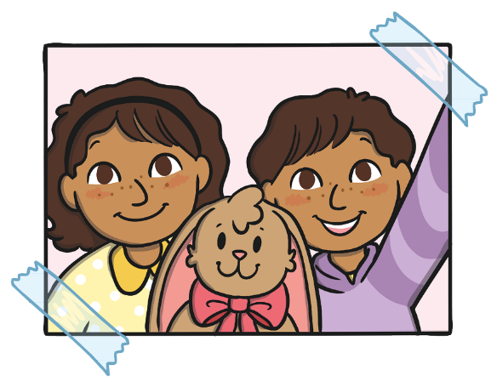
The Easter Journal
Read the book ‘The Easter Journal’ and look at the illustrations.
To see a question about the book, click this button:
?

Slide 3
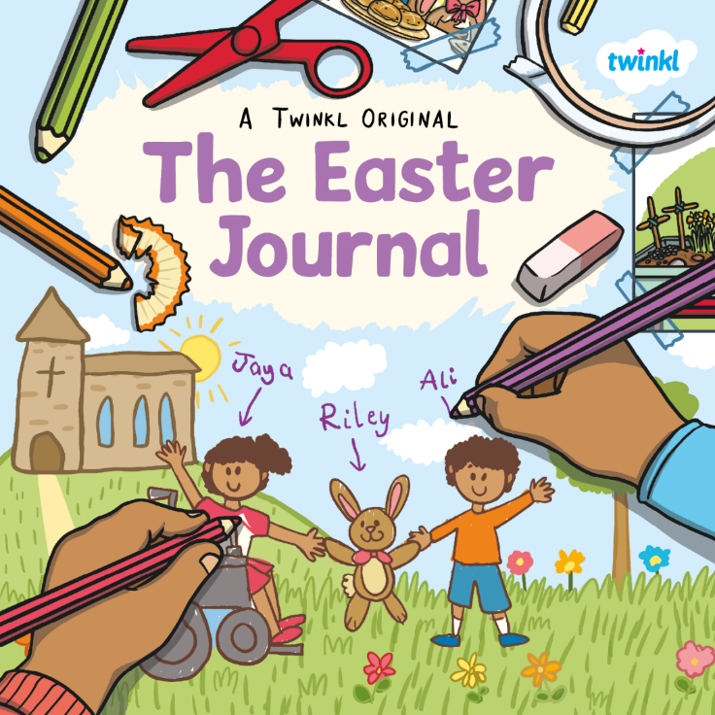
?
What do you think this book is going to be about?
?
Do you think it is fiction or non-fiction?
?
Who do you think the main characters are?

Slide 4
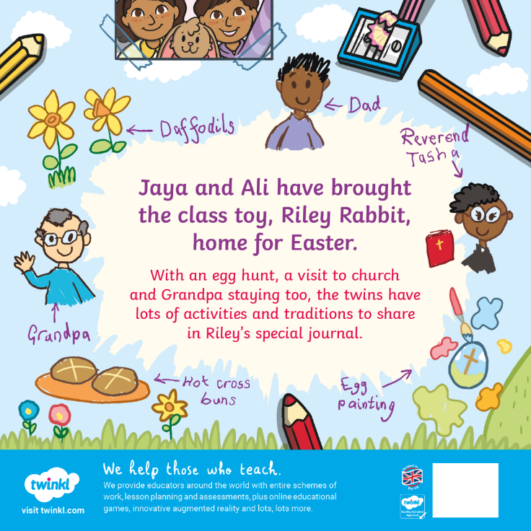
What is a tradition? Can you explain what this word means?
?

Slide 5
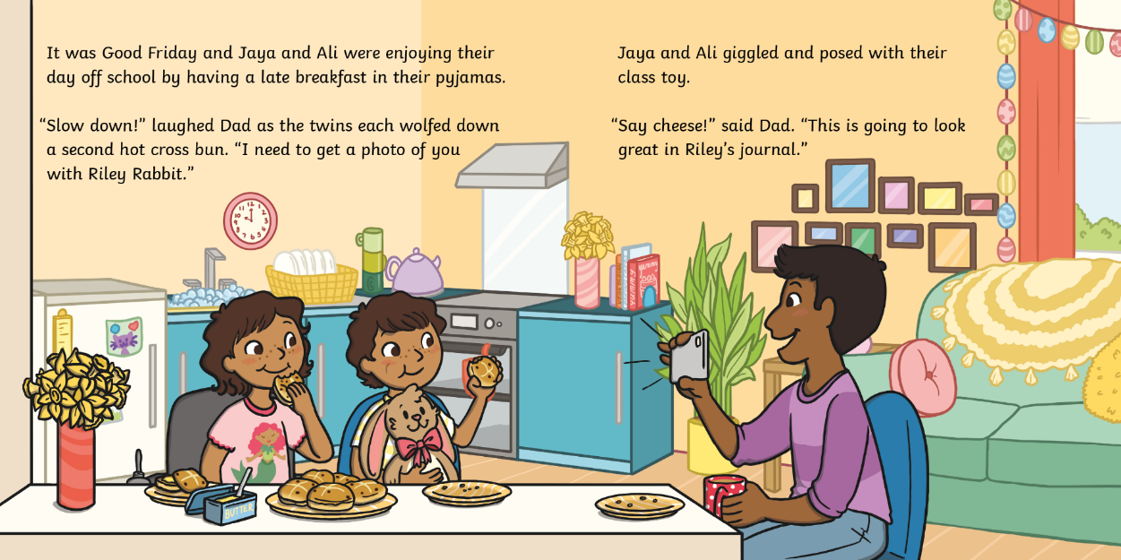
?
Why are Jaya and Ali still in their pyjamas?

Slide 6
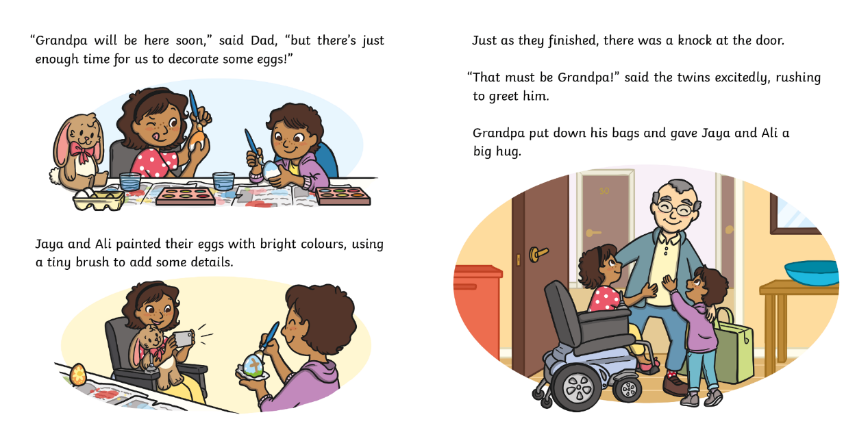
?
Are the children happy to see Grandpa? How do you know?

Slide 7
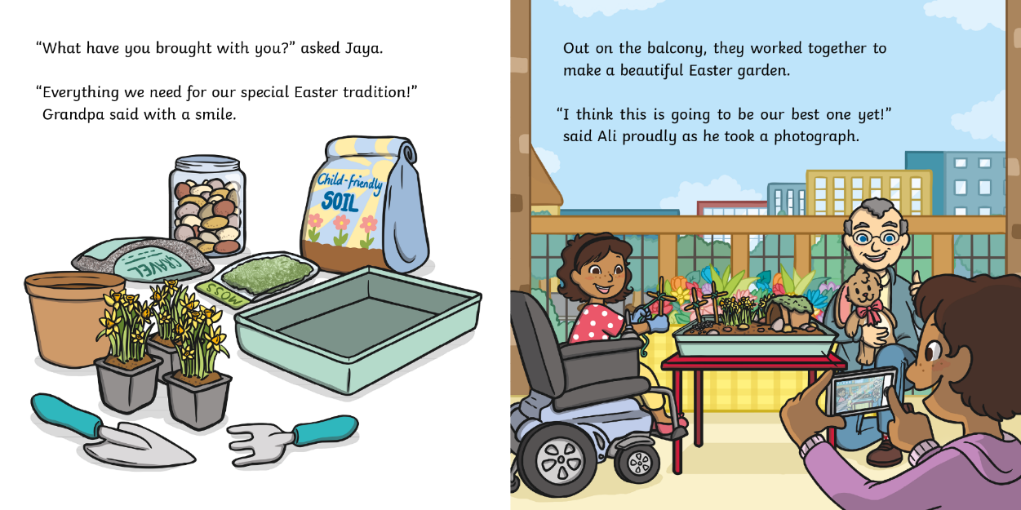
?
What are the twins making?

Slide 8
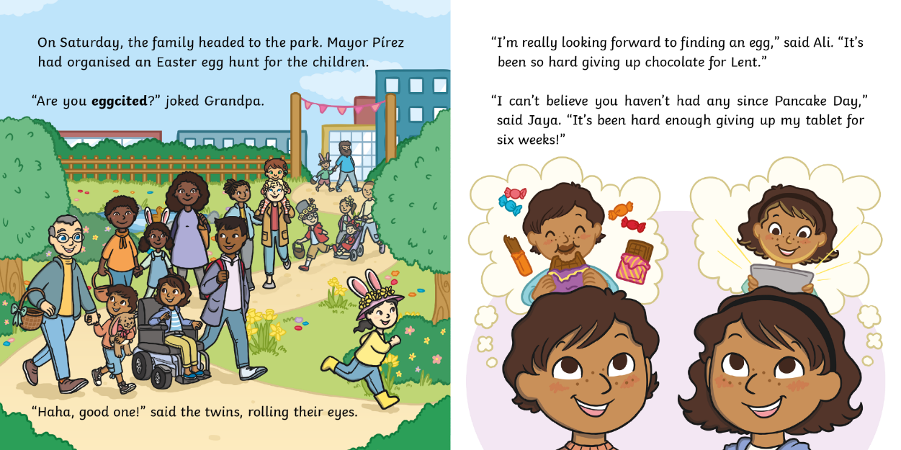
?
Who gave up chocolate for Lent?

Slide 9
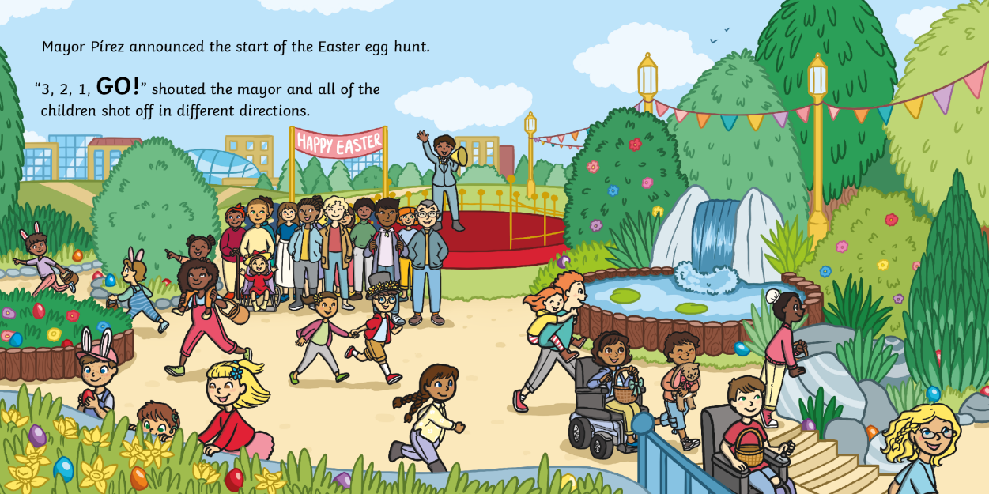
?
What do you think ‘shot off’ means?

Slide 10
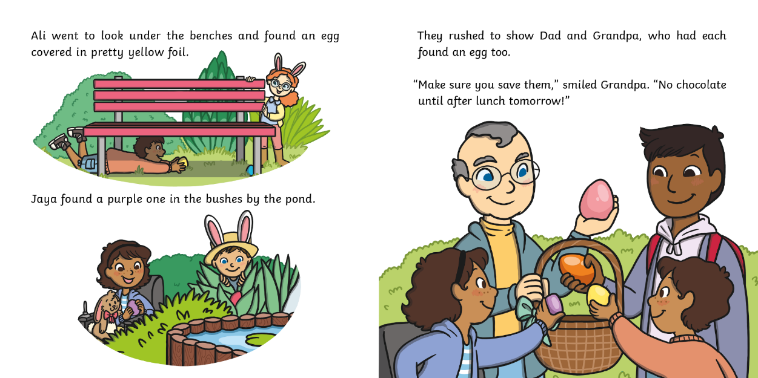
?
Why do you think they are saving the chocolate eggs?

Slide 11
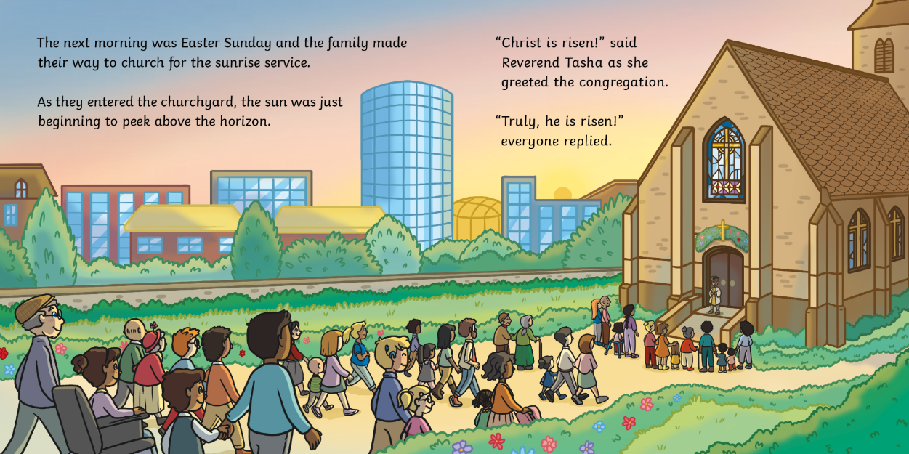
?
What is a reverend?

Slide 12
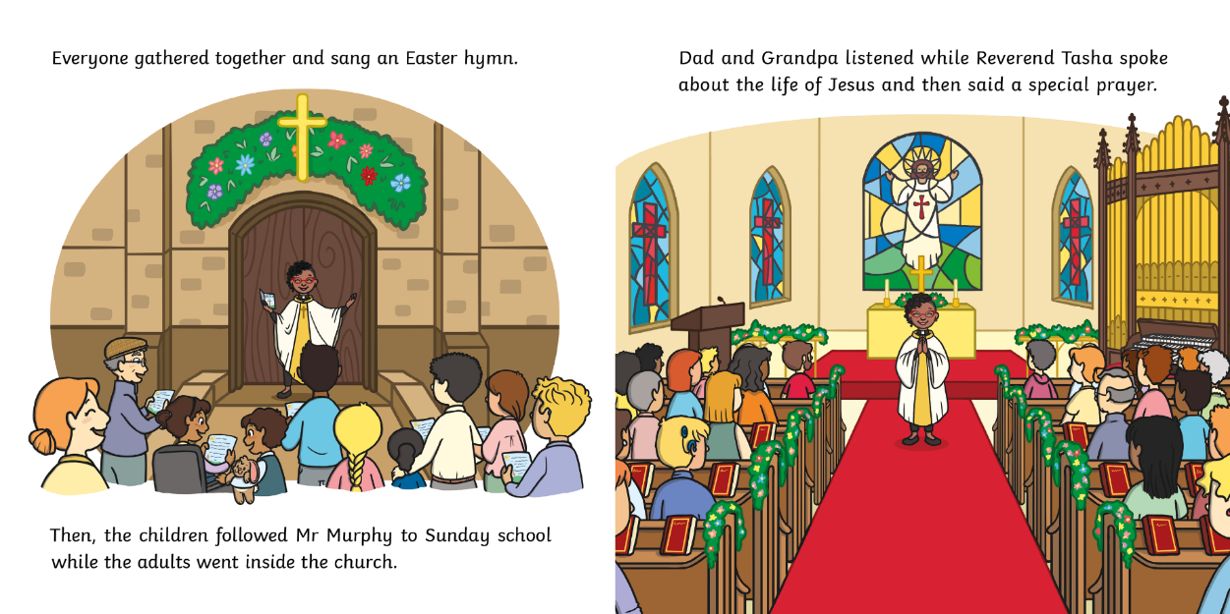
?
Where do Ali and Jaya go?

Slide 13
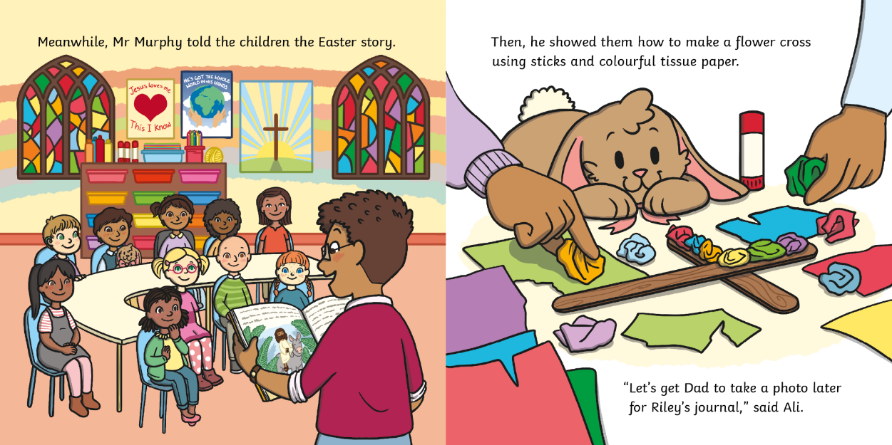
?
What do you think Ali and Jaya are going to do with their photos?

Slide 14
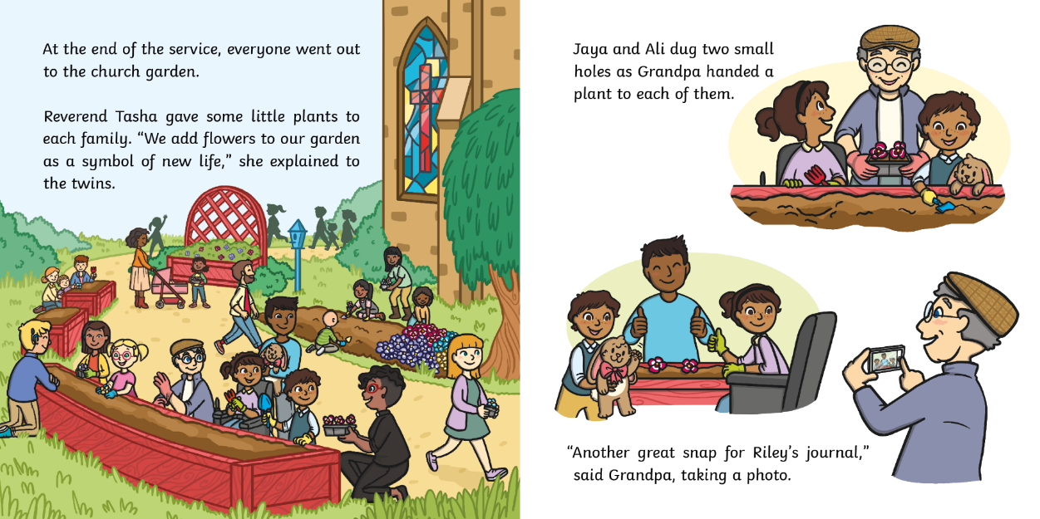
?
Why do the twins plant flowers?

Slide 15
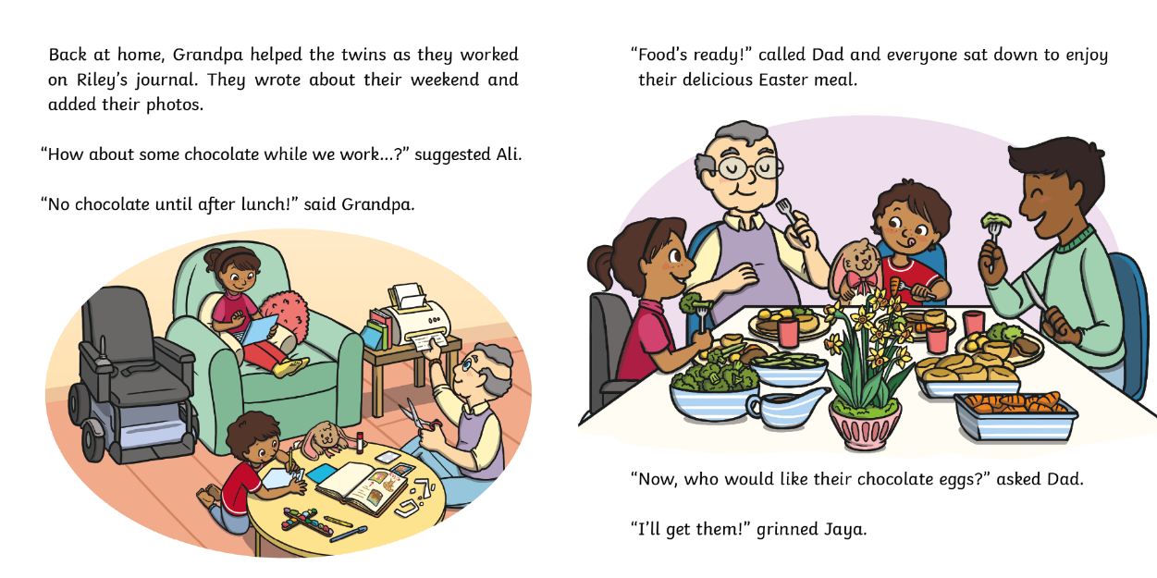
?
What do you think might happen next?

Slide 16
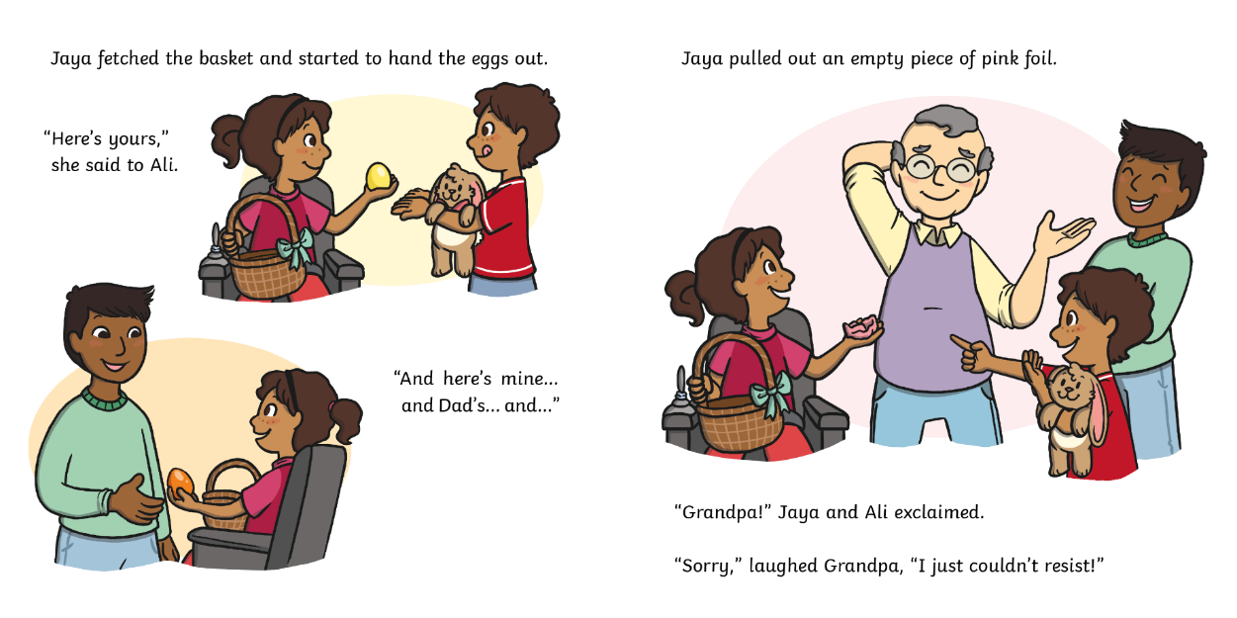
?
What has happened to Grandpa’s chocolate egg?

Slide 17
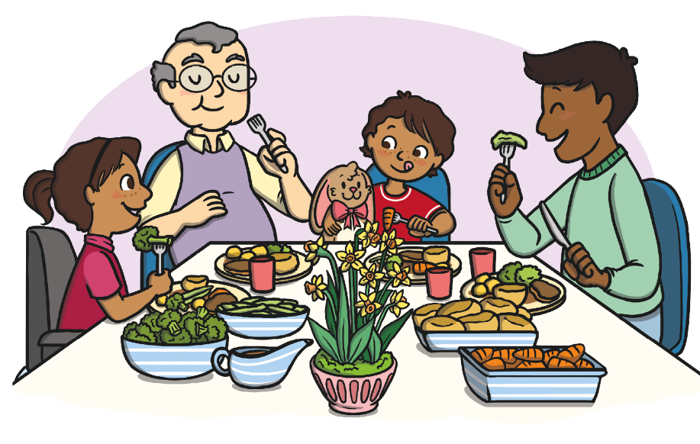
?
What are the family in the story celebrating?
spring
Christmas
Easter

Slide 18
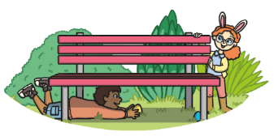
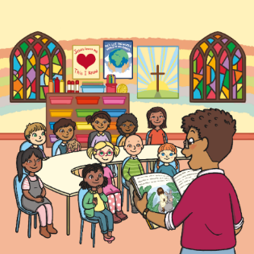
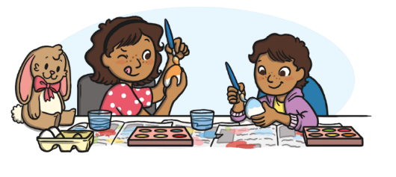
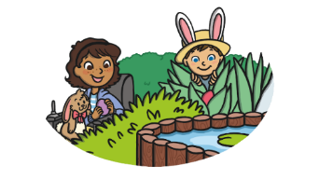
?
What do the children do first?
an egg hunt
egg decorating
Sunday school

Slide 19
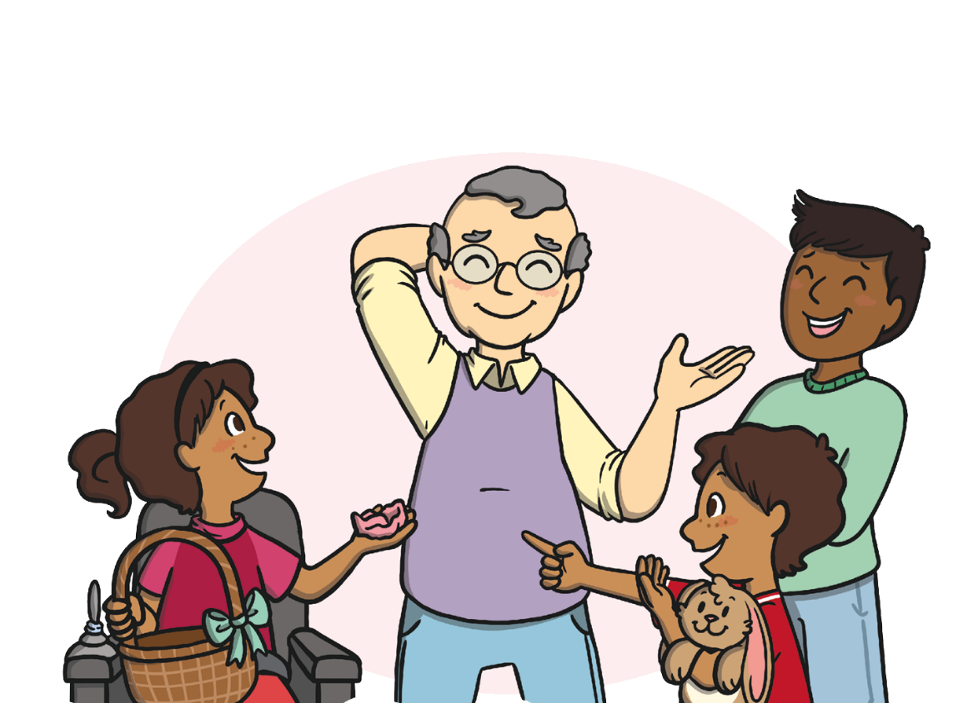
?
How do you think the children feel when they find out that Grandpa has already eaten his chocolate egg?

Slide 20
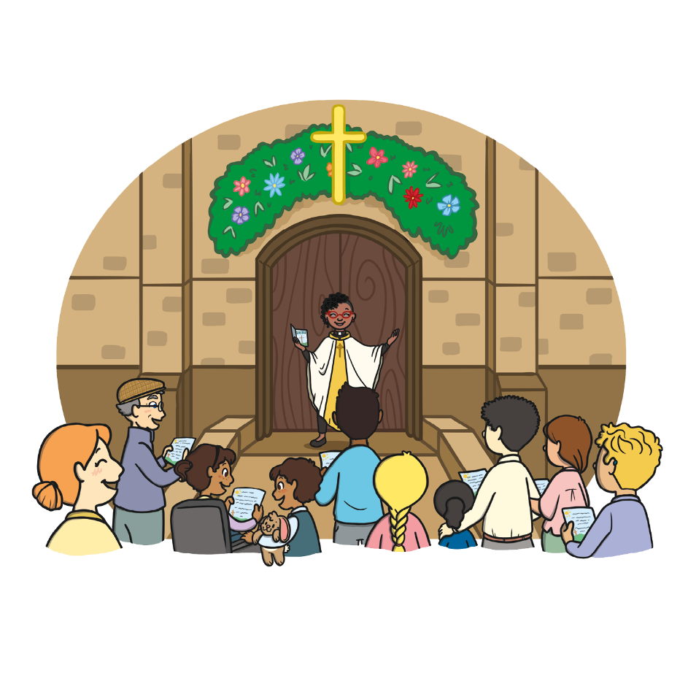
?
Do you celebrate Easter? Have you ever done any of the activities in the story?
?
Do you celebrate anything else?

Slide 21
?
What was your favourite part of the story?
?
Would you recommend this book to a friend?

