Slide 1


Slide 2


Slide 3
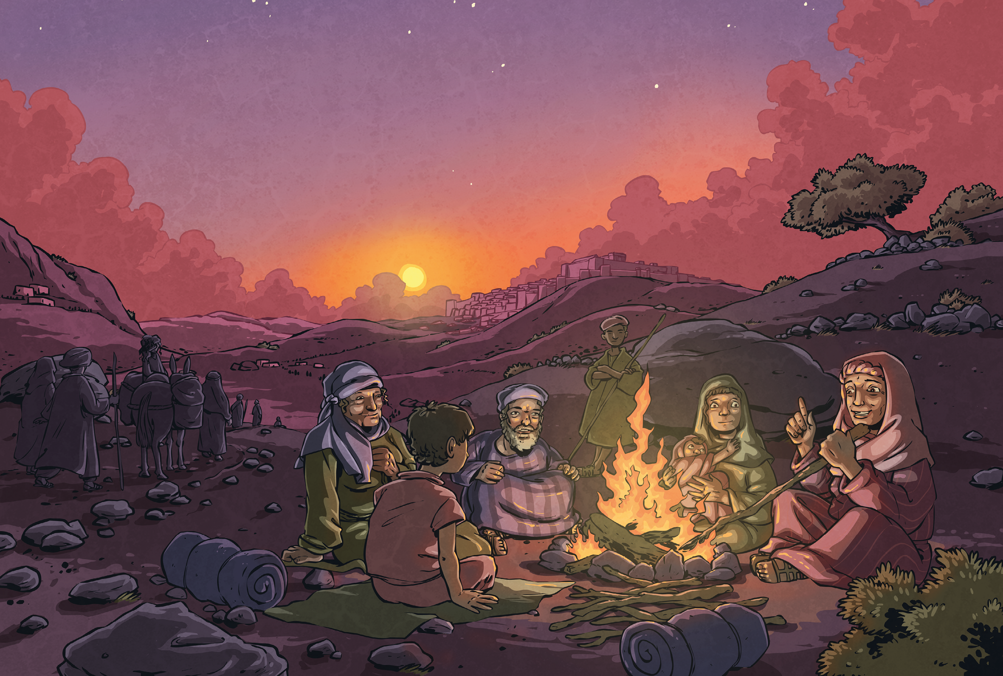
Yes, I have travelled to Jerusalem before – only once, many years ago when I was a girl. We came for the Passover festival and I was so excited about my first visit to the Holy City. I tried hard to imagine just how big the crowds filling the streets would be. I was sure that the feast would be extraordinary!
Sure enough, something extraordinary did happen that year. It was all to do with a man named Jesus…

Slide 4
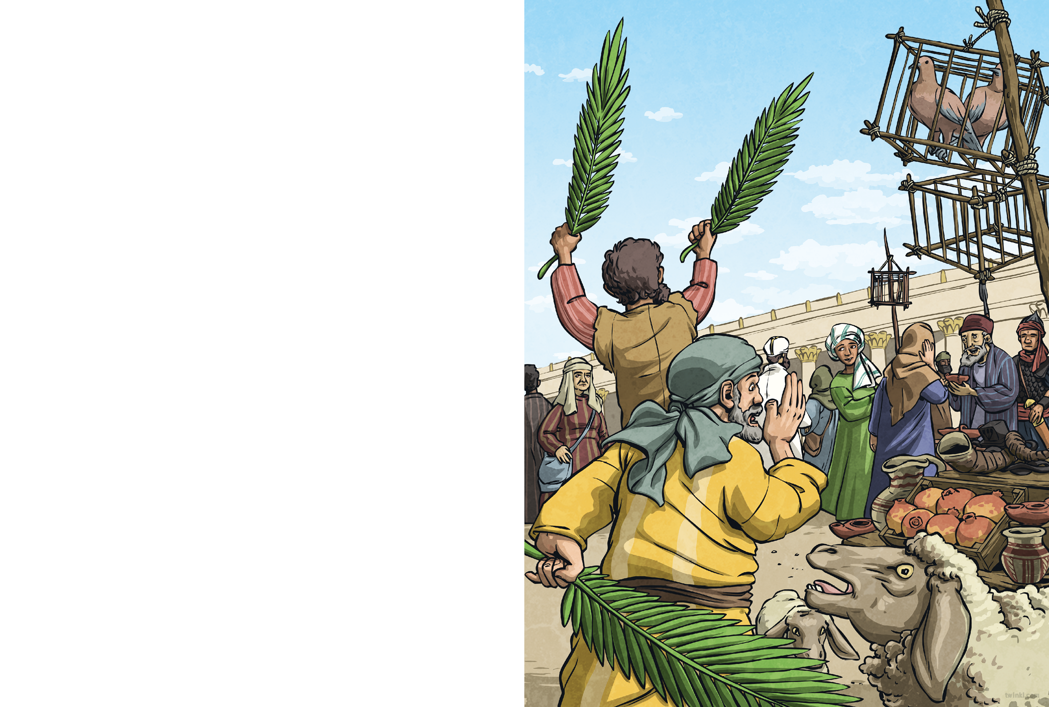
Jerusalem bustled. The inns and guest houses for miles around were full to bursting, and tents crowded the slopes below the city.
In the shadow of the Golden Gate, we sampled fish and fruit. Merchants sold bleating sheep and cooing doves; pilgrims exchanged their money for Tyrian coin and haggled over the price of prayer shawls and shofars. The market was so busy that it was impossible to walk without being jabbed by elbows or trampled by sandals.
That’s when we overheard the gossip. Sure enough, something extraordinary did happen that year. It was all to do with a man named Jesus…
“The King of the Jews is here! Move aside!”
Gabbling and pushing, the crowd drew back. Some laid palm fronds on the dusty road. Whoever was coming, he had to be really important.

Slide 5
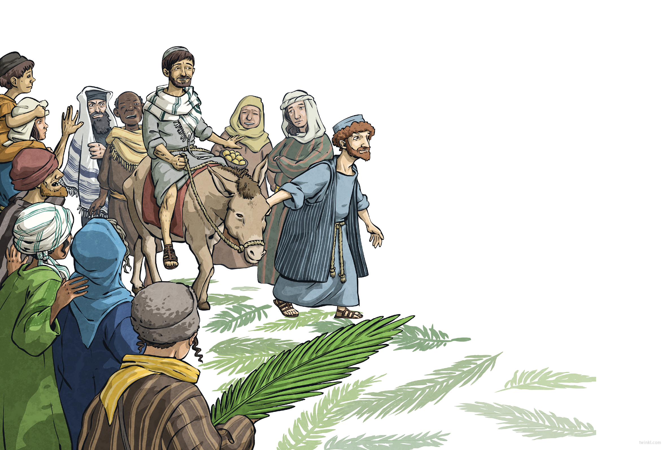
Then, we saw him: a man riding on a donkey. He didn’t look rich, powerful or special in any way, but all around, the crowd began to shout, “Blessed is the king! Peace in heaven!”
“Who is he?” said a voice, and answers flew from every side.
“He’s a teacher!”
“No, he’s a madman!”.
“Wherever he goes, he curess
the sick, the deaf and the blind.”
“Wherever he goes, he angers people.”
“He’s the Messiah – the Son of God.”
“Look, he’s going into the temple.
Let’s hear what he has to say.”
Some doubted him, some were devoted to him, but everyone swept eagerly into the temple. Little did anyone know that at that very moment, a few streets away, a plot was brewing – a plot against Jesus.

Slide 6
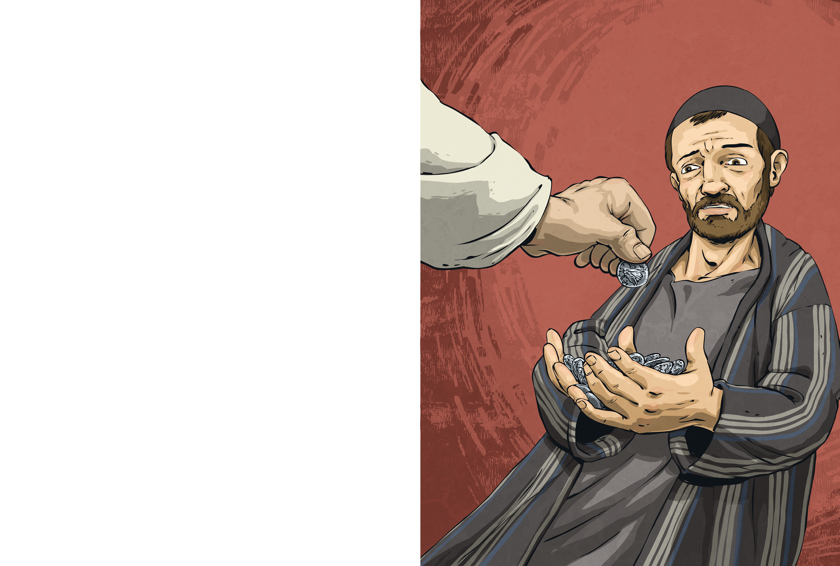
While the crowd heard Jesus preach, the High Priest Caiaphas met with all the elders of the Jewish temple. They had gathered at his palace to discuss how they could arrest Jesus – arrest him and kill him.
“That young upstart! Who does he think he is?”
“He says that he’s the Son of God!”
“He must be dealt with before he turns the people against us.”
Caiaphas called for order. “The people are listening to this man, and soon, they will stop listening to us. I have been High Priest too long to let this commoner steal my power. If we condemn Jesus publicly, the crowd will turn on him. But first, we must find him when he is alone.”
That’s when a man arrived at their gathering. His name was Judas Iscariot, and he was one of Jesus’ disciples.
“What will you give me if I agree to betray Jesus?” asked Judas
Caiaphas counted out thirty silver pieces into Judas’ palm.

Slide 7
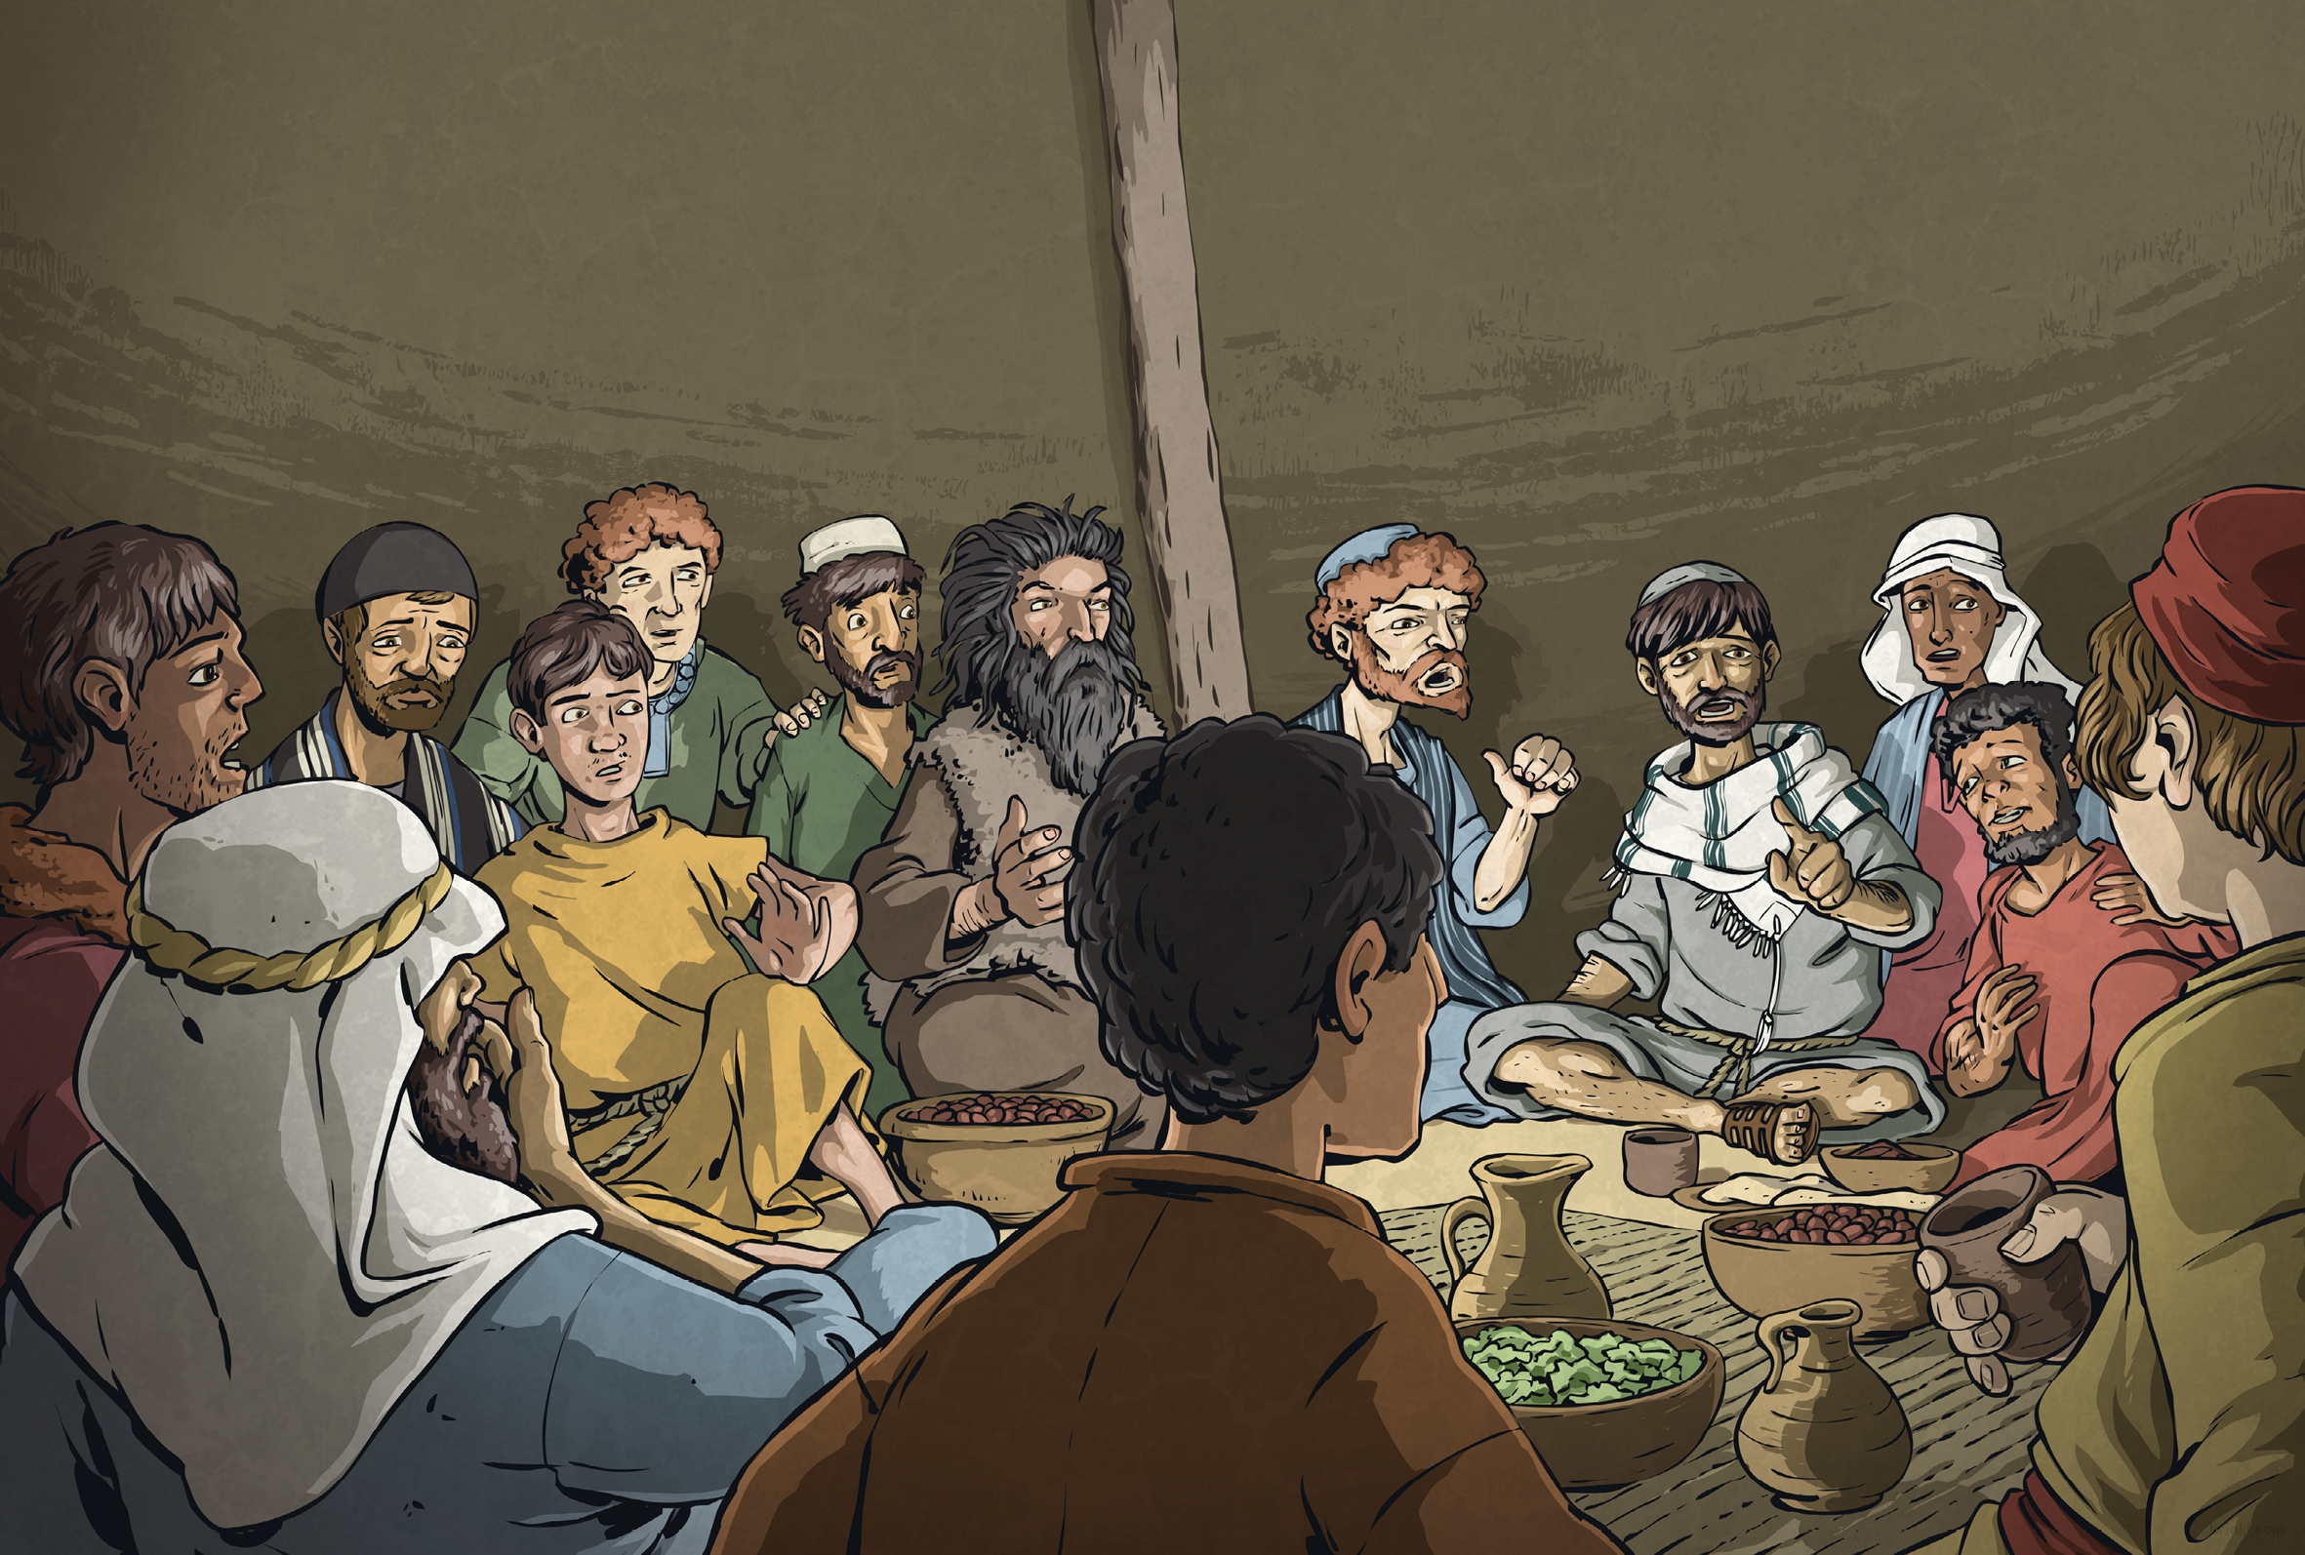
Soon afterwards, Jesus sat with his followers in a house in the city as they ate their Passover meal. He shared bread and wine with the disciples, saying, “This bread is my body and this wine is my blood.”
Then, he looked around at the twelve men who travelled with him wherever he went and said, “Soon, you will all leave me.”
Shocked, the disciples insisted that it wasn’t so. None was surer than Peter.
“Peter,” said Jesus kindly, “you will deny me three times before the rooster crows for morning.” As Peter sat speechless, Jesus continued. “What’s more, one person here will be my betrayer. This is the last supper that I will share with you, for tomorrow I will die.”
The disciples fell silent.
Then, Jesus said, “But after that, I shall rise and go north, to Galilee.
Meet me there.”
Just imagine the looks on the disciples’ faces then!
“My Lord, I never would!”

Slide 8
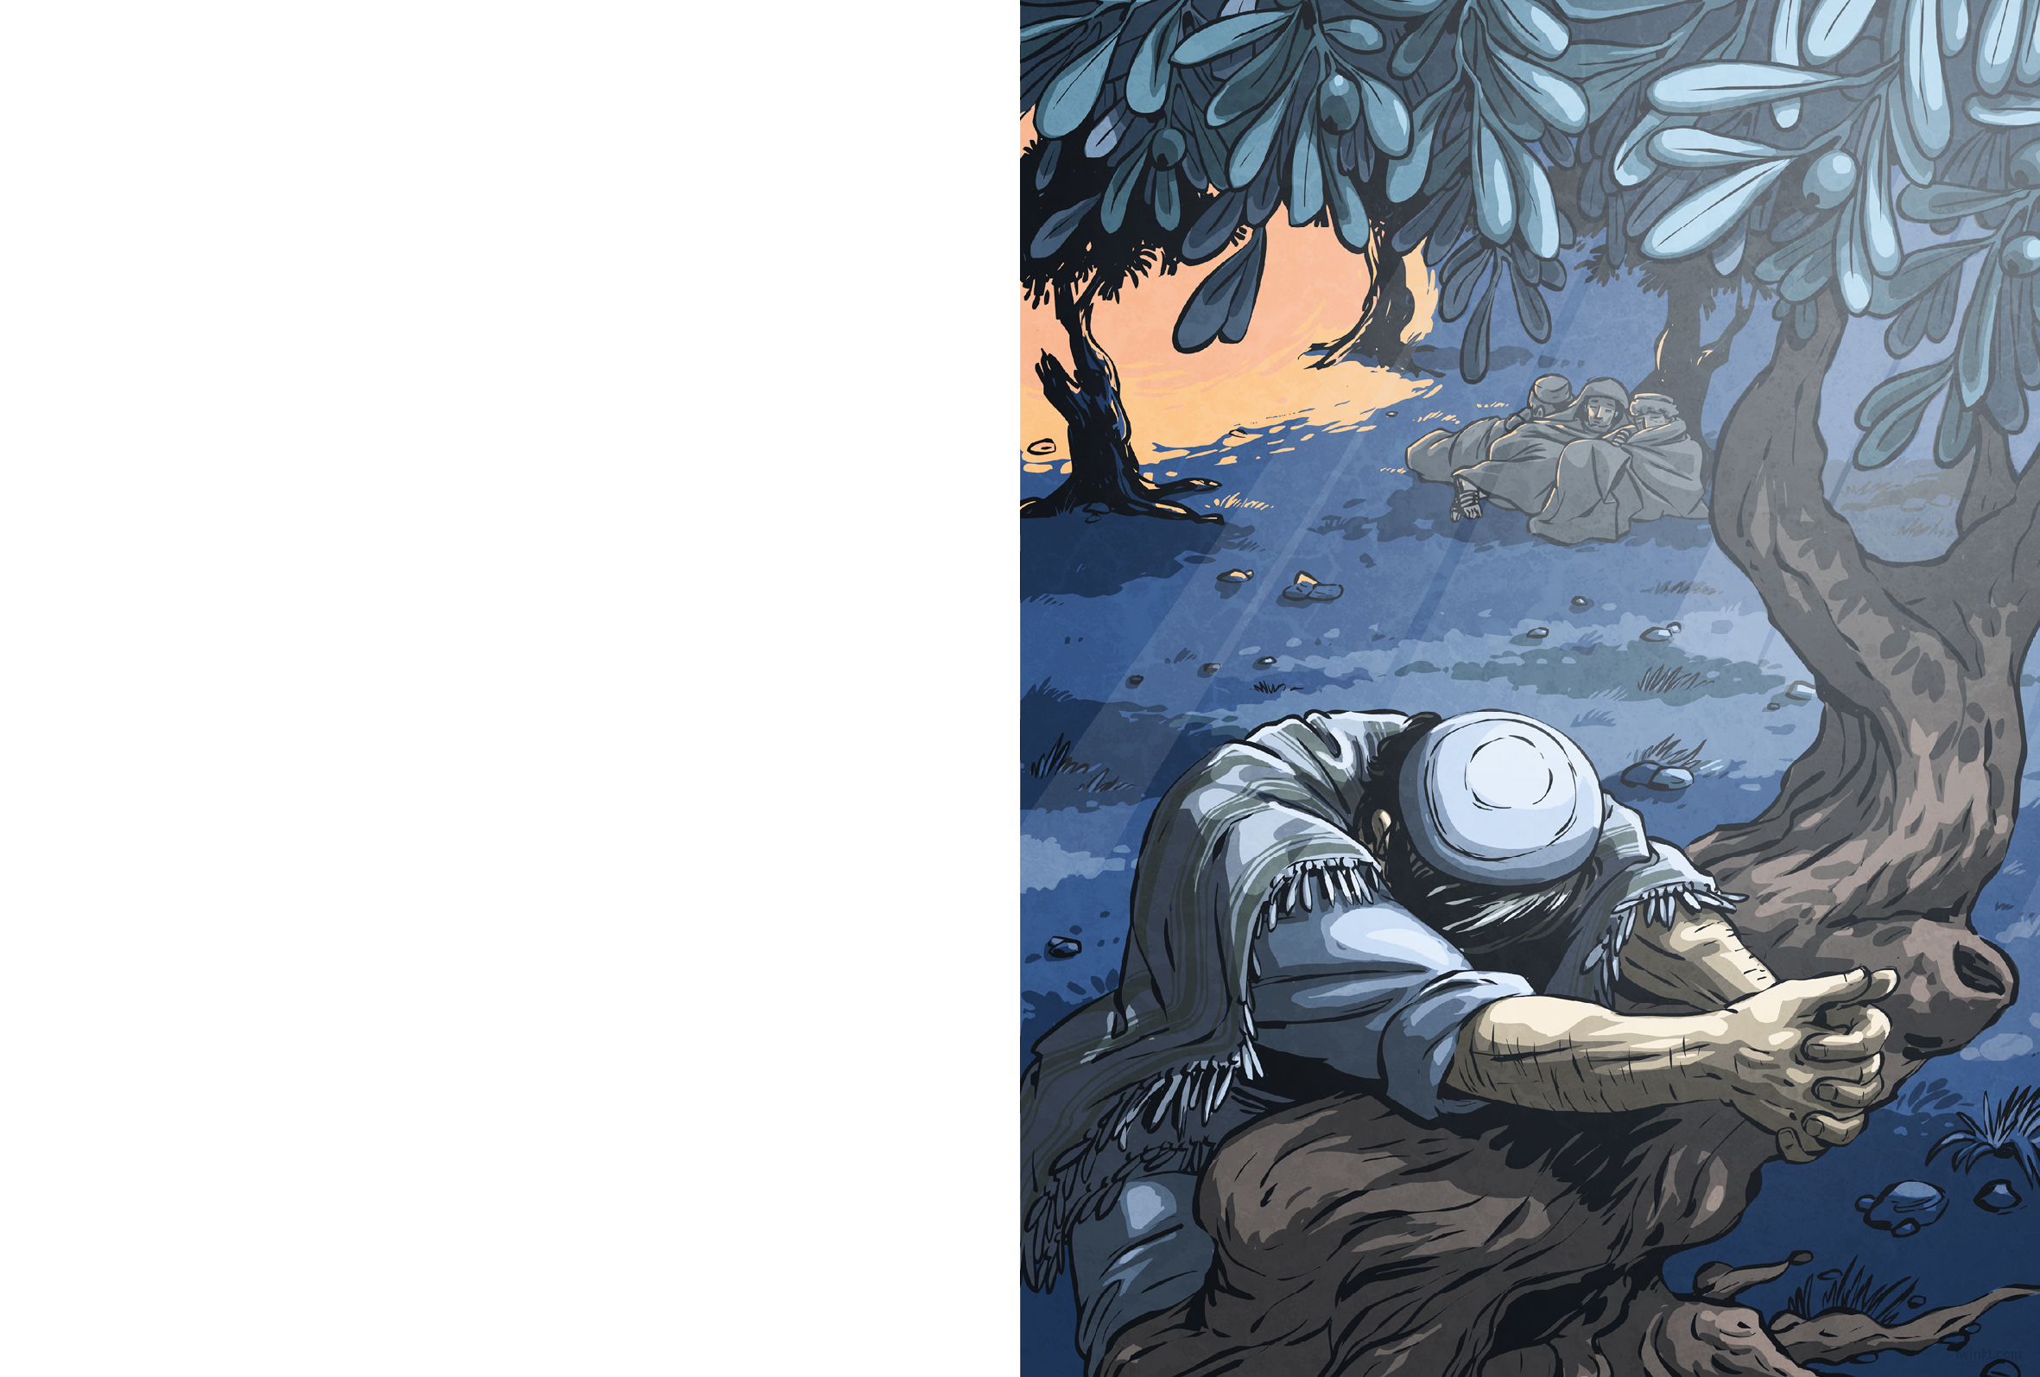
After supper, Jesus went to the Garden of Gethsemane to pray. That night, the air of Jerusalem hung still and heavy with the scent of almond blossom. The olive trees stood guard like gnarled sentinels.
Though he had seemed calm at supper, Jesus was troubled.
“Please, watch over me,” he told his companions as he knelt to pray.
Some say he prayed so earnestly that an angel appeared to him and blessed him with strength for the trials ahead. He prayed so feverishly that sweat poured down his face. He prayed for so long that when he returned to his disciples, they were sleeping.
“Wake up!” he commanded. But at that moment, the darkness of evening was dispersed by golden light, which flooded into the garden and bounded from tree to tree.

Slide 9
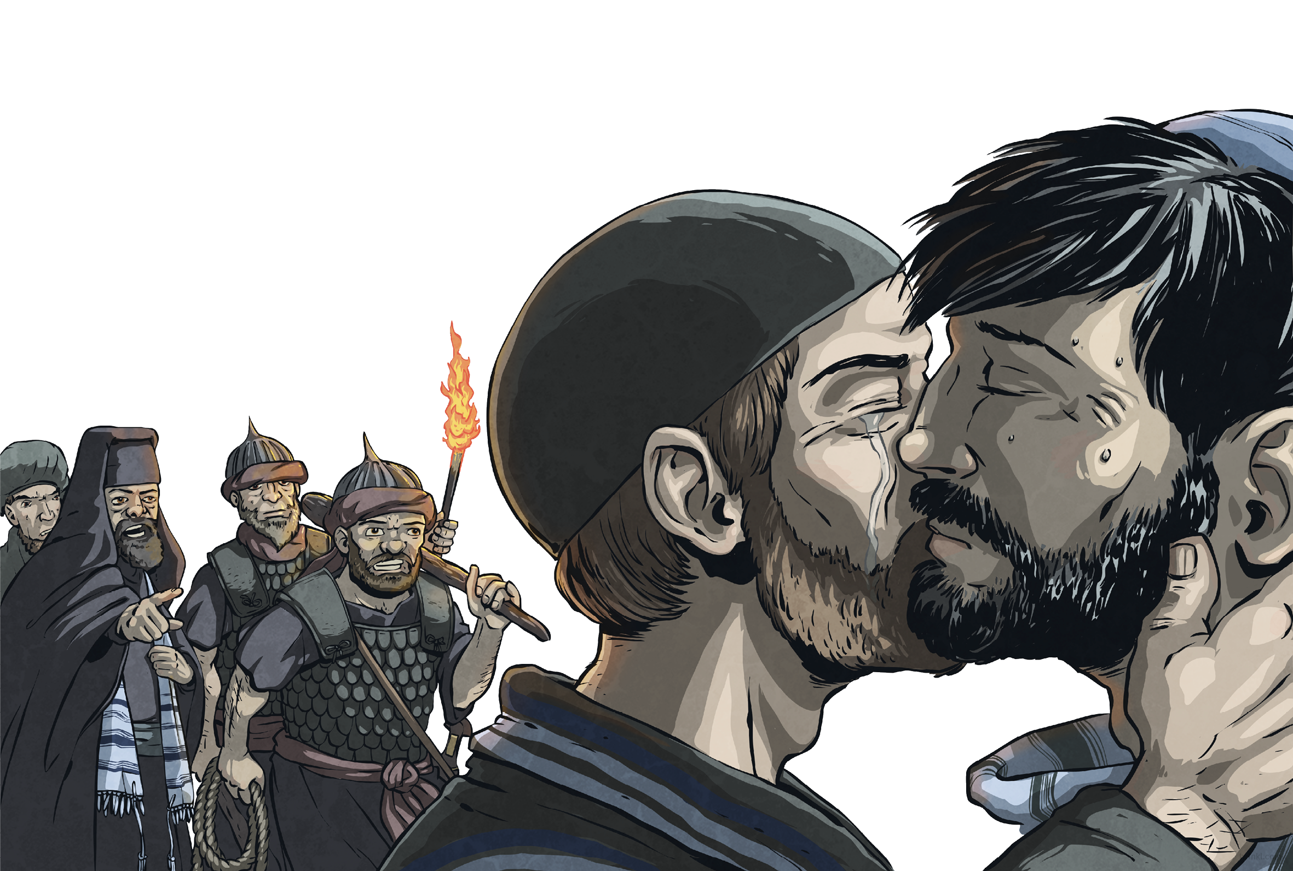
Priests and soldiers crowded into the garden, waving torches and clubs. As Jesus turned to face the light, Judas stepped forwards from among them and greeted him with a kiss on the cheek.
This was the signal that the soldiers had been waiting for. With a roar, they surged forward, seized Jesus and marched him from the garden.
As Jesus was led away, the disciples fled into the darkness.

Slide 10
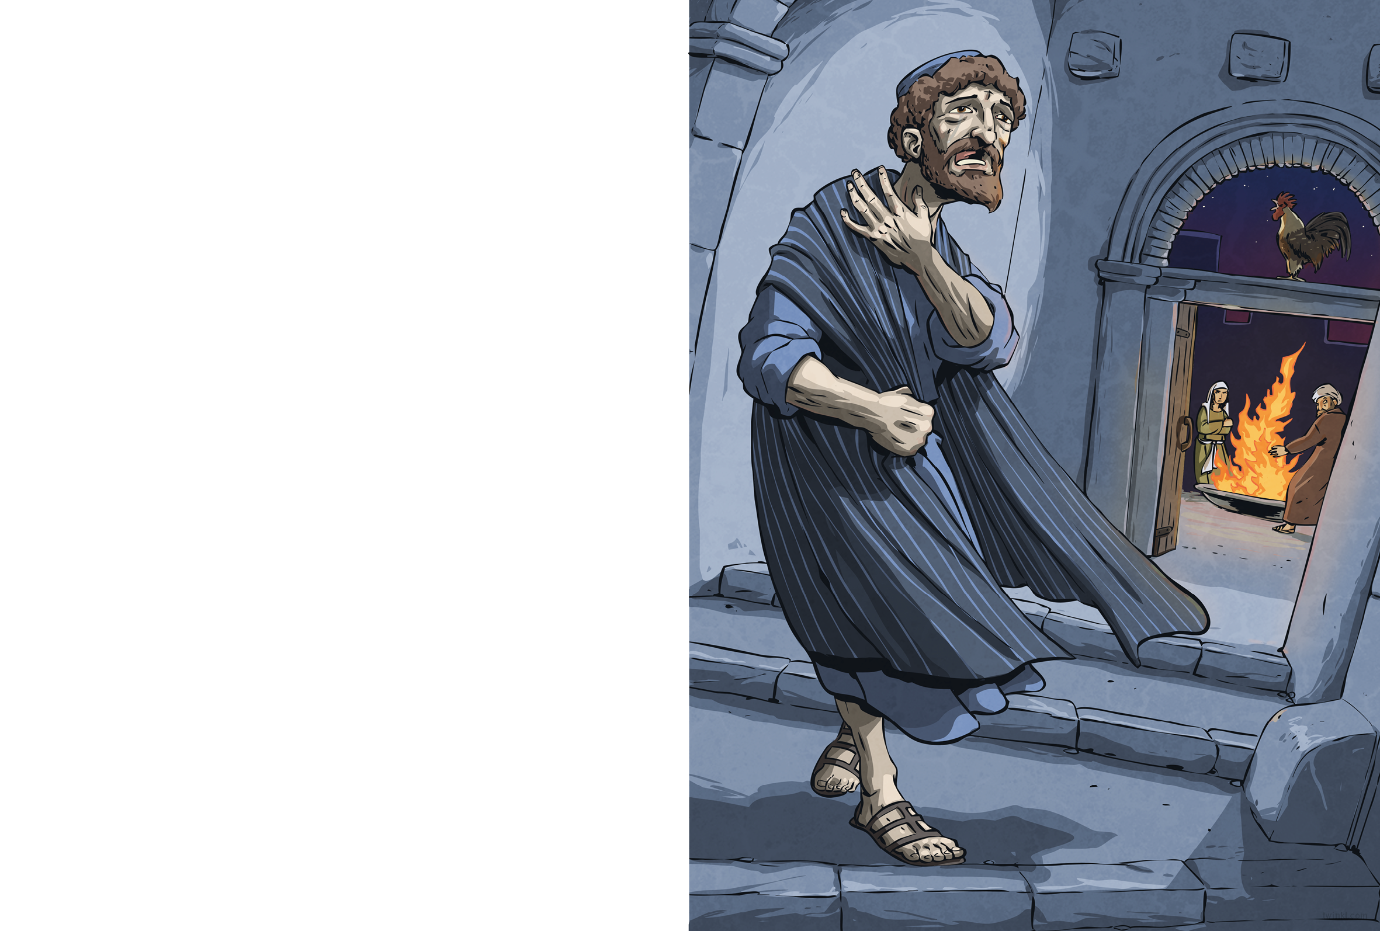
The soldiers led Jesus to the palace of Caiaphas. Peter followed at a distance, desperate for news. He trembled from head to foot.
As Peter waited in the courtyard to hear what the elders would accuse Jesus of, a servant girl noticed him.
“You’re one of Jesus’ men, aren’t you?” she asked.
Peter jumped. “I don’t know what you’re talking about!” he said at once.
“Yes, you are,” said another girl. “I can tell by your accent.”
“I don’t know the man!”
“You do, you do – I saw you together,” said a third.
“No, no!” cried Peter.
At that moment, the rooster crowed to signal morning, and Peter remembered what Jesus had foretold. As he ran from the courtyard, shame burned in his chest.

Slide 11
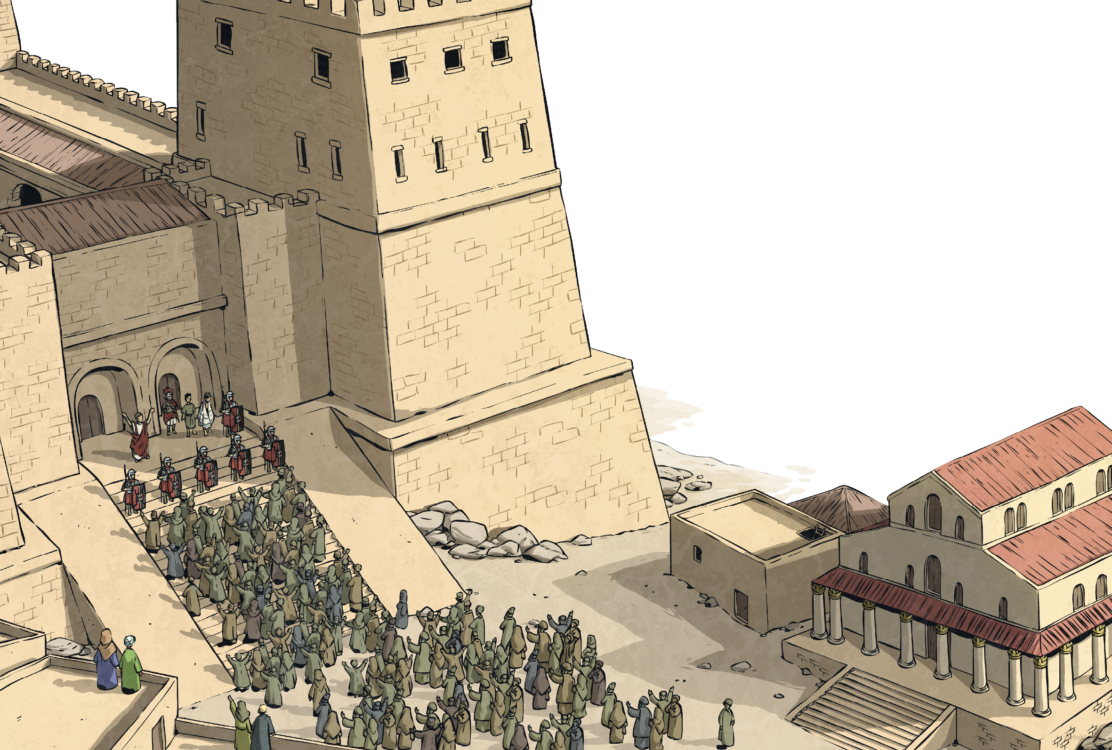
But all that, I only learnt later. The first I heard of it was in the morning, outside the governor’s palace. The Roman governor’s name was Pontius Pilate and that morning, he brought Jesus and another prisoner before the crowd. The priests had accused him of blasphemy; the governor did not like the people calling him ‘King’. Neither the priests nor Pilate had found enough evidence of Jesus’ wrongdoings to sentence him to death, so Pilate had decided to let the people decide his fate.
“Since it is Passover, you may choose one prisoner to go free,” Pilate announced. “The first is Barabbas: a rebel and a murderer. The other is Jesus, whom you call ‘King of the Jews’.”

Slide 12
At that, the crowd near the steps began to chant: “Crucify him! Crucify him!”
Jesus’ face didn’t change. He wasn’t shocked or angry; it was as if he had expected this.
Pilate asked the crowd, “What crime is he guilty of?” Undeterred, the crowd chanted louder and louder.
At last, Pilate shrugged. “Fine. Barabbas will be freed and Jesus
will be crucified. I wash my hands of this.”

Slide 13
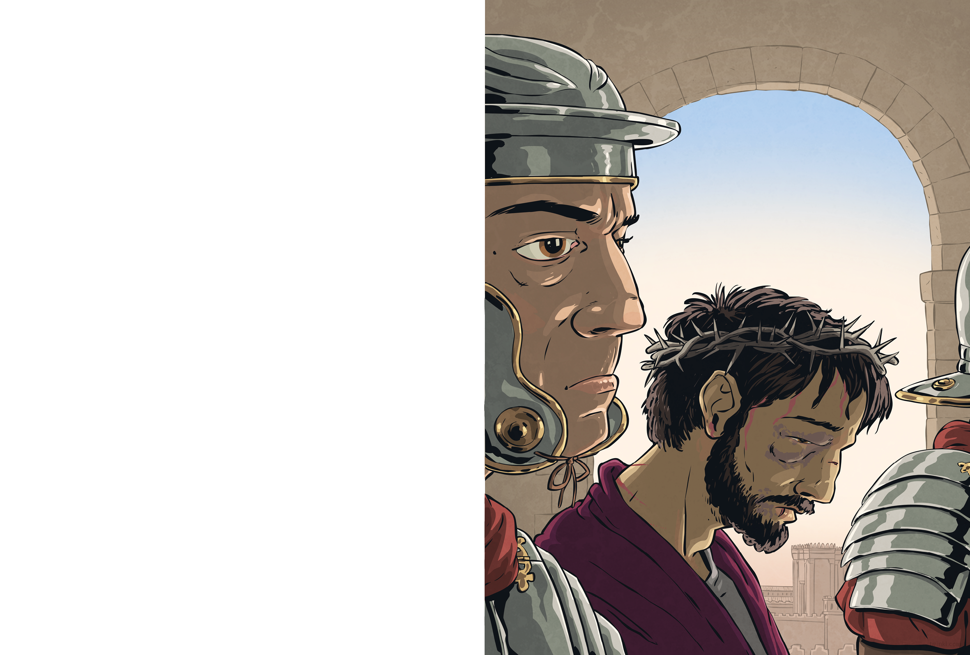
On Pilate’s orders, Jesus was marched away and dragged into the palace. We heard Jesus’ cries as they beat him.
Soon, the soldiers began to laugh. “Hail, King of the Jews!” they mocked. “Hail! Hail!”
When they pushed Jesus outside, we saw what the soldiers had done. He was dressed in a richly-coloured robe, like a king. On his head rested a crown of thorns.
The soldiers spat at him, struck him and stripped him of his kingly robe, but the crown remained, its cruel thorns digging into Jesus’ flesh.

Slide 14
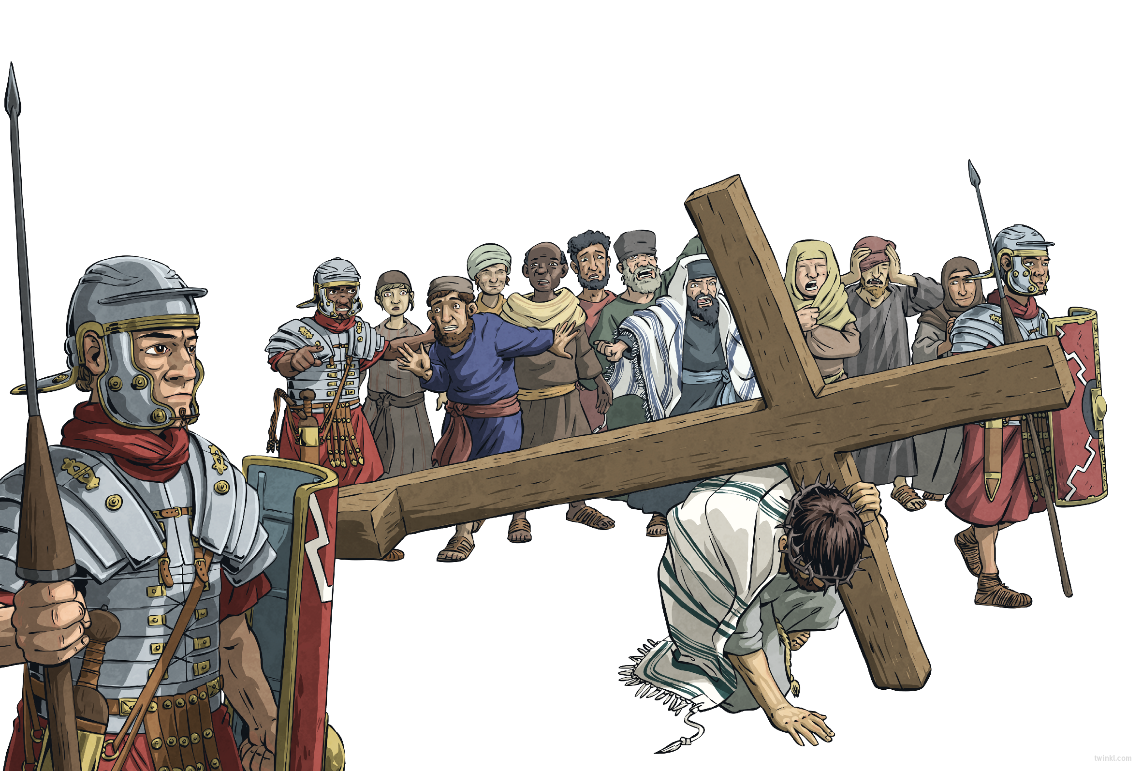
So, Jesus was led to Golgotha – ‘the Place of the Skull’. Some say that he carried his own cross, and others say that the soldiers made a man called Simon of Cyrene carry it most of the way.
Jesus was one of three to be crucified that day. Everyone watched as the soldiers offered him bitter wine and as he refused it. Everyone held their breath as the soldiers divided up Jesus’ clothes.
Then, the soldiers nailed Jesus to the cross by his hands and feet, and hoisted him aloft. Above him hung a sign:
This is Jesus, King of the Jews.

Slide 15
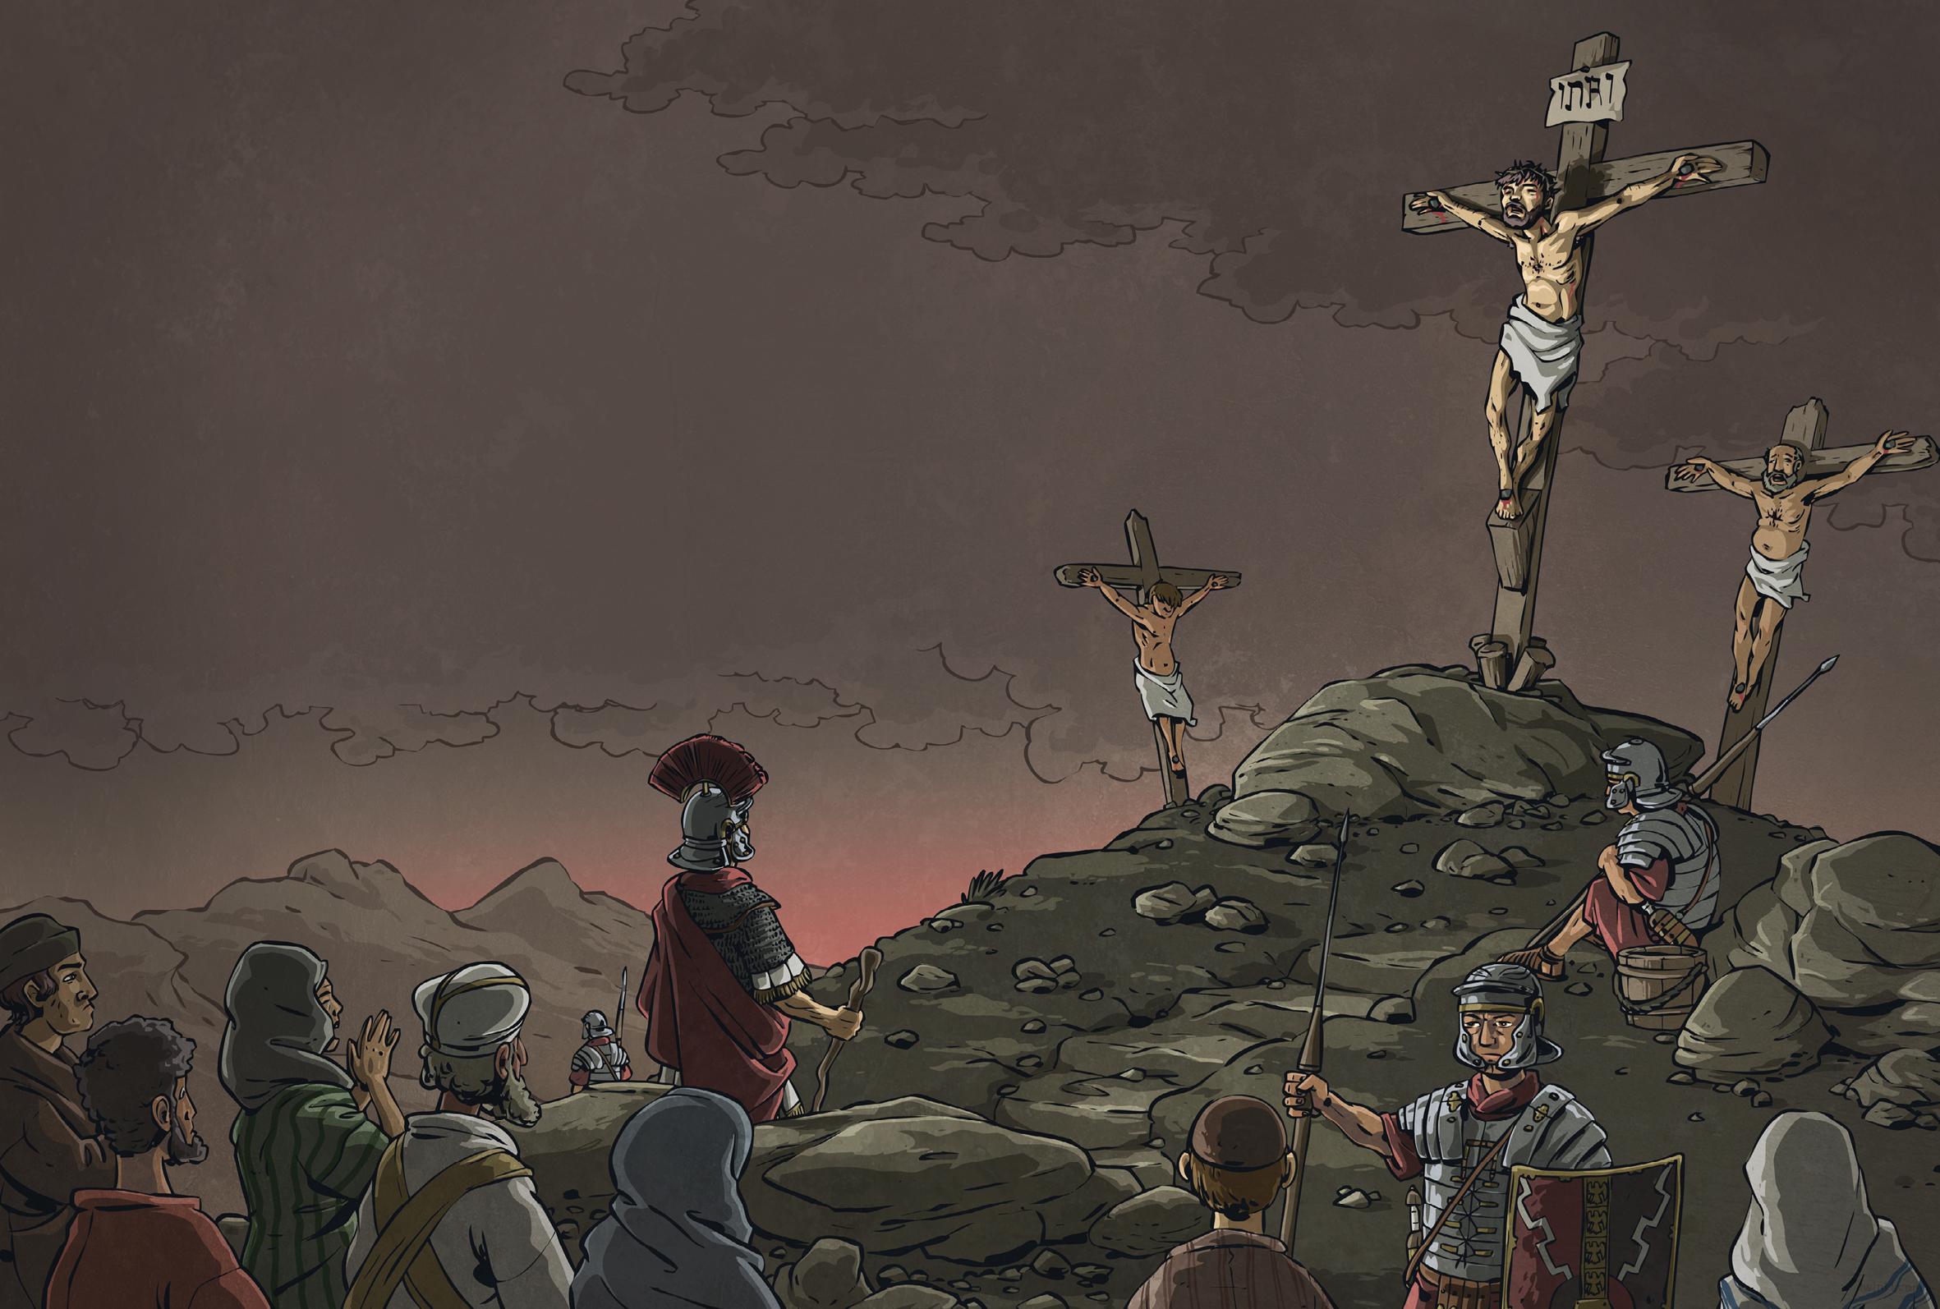
We waited.
At noon, the sky turned black. And still, we waited.
At three, Jesus cried out with a sound that seemed to shatter the sky.
The earth shook.
Quaking, the centurion who guarded Jesus cried out,
“Surely, he was the Son of God!”

Slide 16
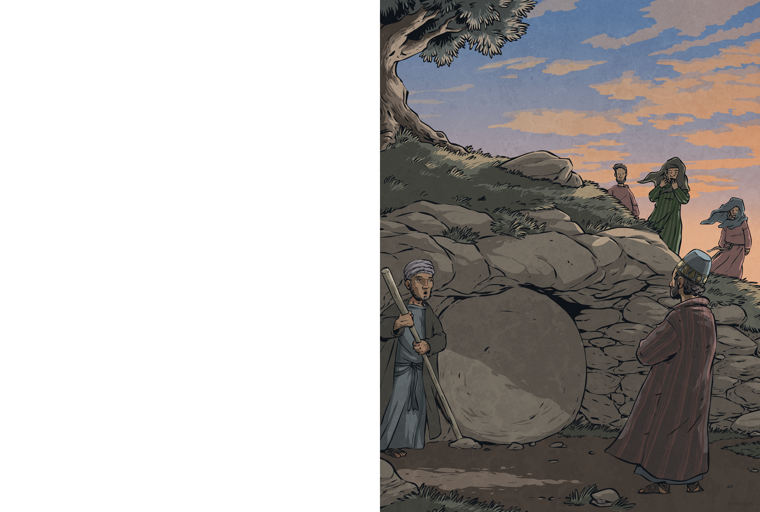
A rich man named Joseph of Arimathea asked the governor for Jesus’ body. With Pilate’s permission, he wrapped Jesus in linen cloth and carried him away.
Joseph had a tomb close by, hewn from rock. He placed Jesus inside. Nearby stood the women who followed Jesus; among them was Mary Magdalene, who had travelled with Jesus through Galilee ever since Jesus had healed her. The women watched sombrely as Joseph’s servant rolled a huge stone across the entrance of the tomb.
Jesus had been betrayed and denied, and now he lay in a tomb – but that wasn’t the end of the story...

Slide 17
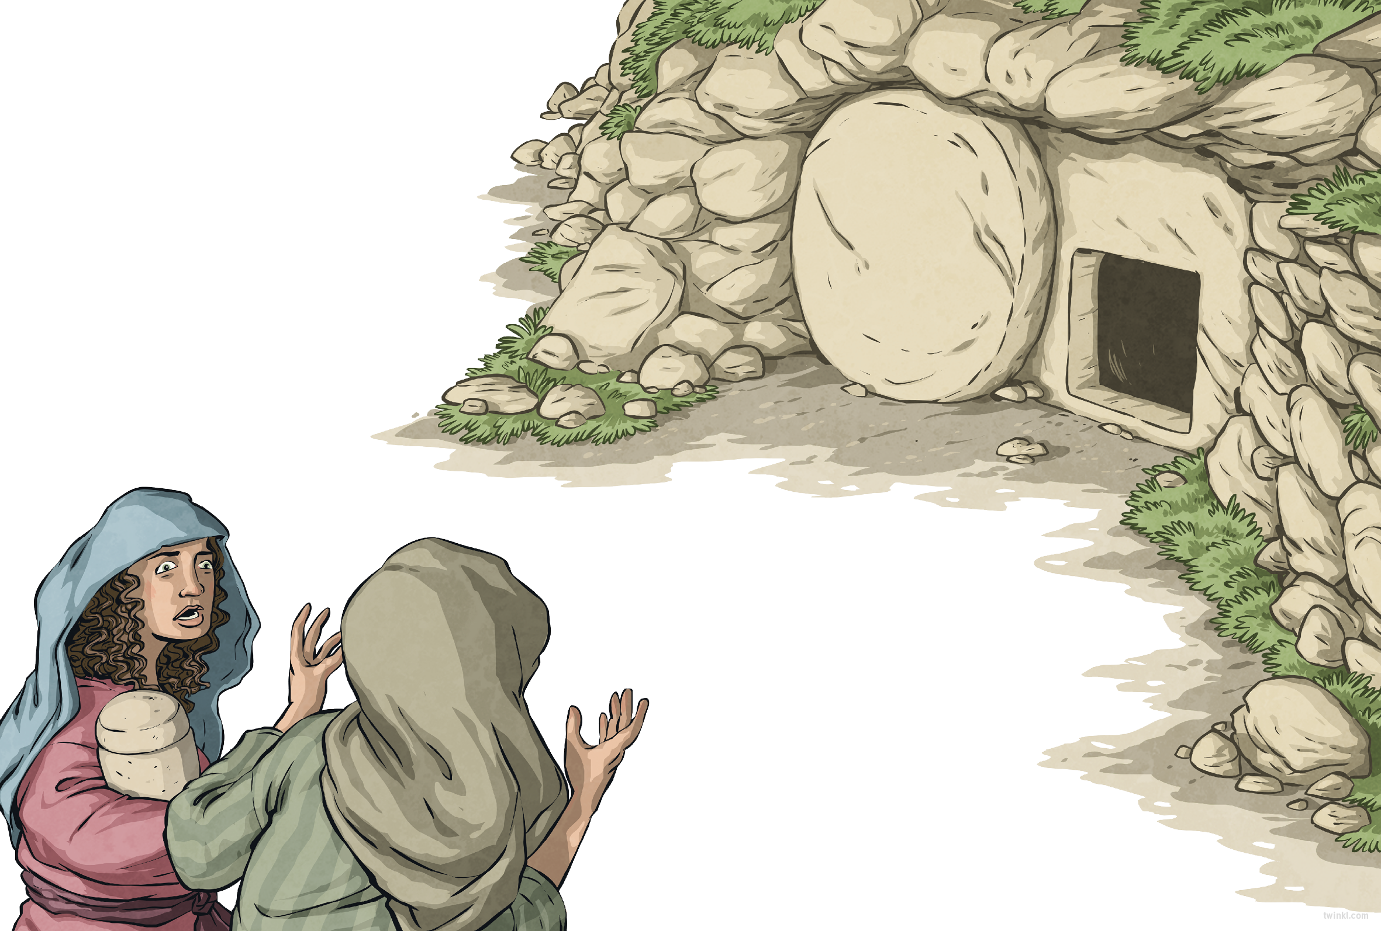
The next day was the Sabbath: a day of rest in the midst of festivities. The following day – the third day after Jesus’ death – something very strange happened.
That morning, as the sun rose, Mary Magdalene and the other women returned to the tomb with spices to anoint Jesus’ body. The crunching of their feet broke the stillness of the morning and the air was threaded with the scent of blossom.
As they entered the garden, a sight
greeted the women that made them
stop in their tracks...
The stone covering the tomb’s entrance
had been rolled away.

Slide 18
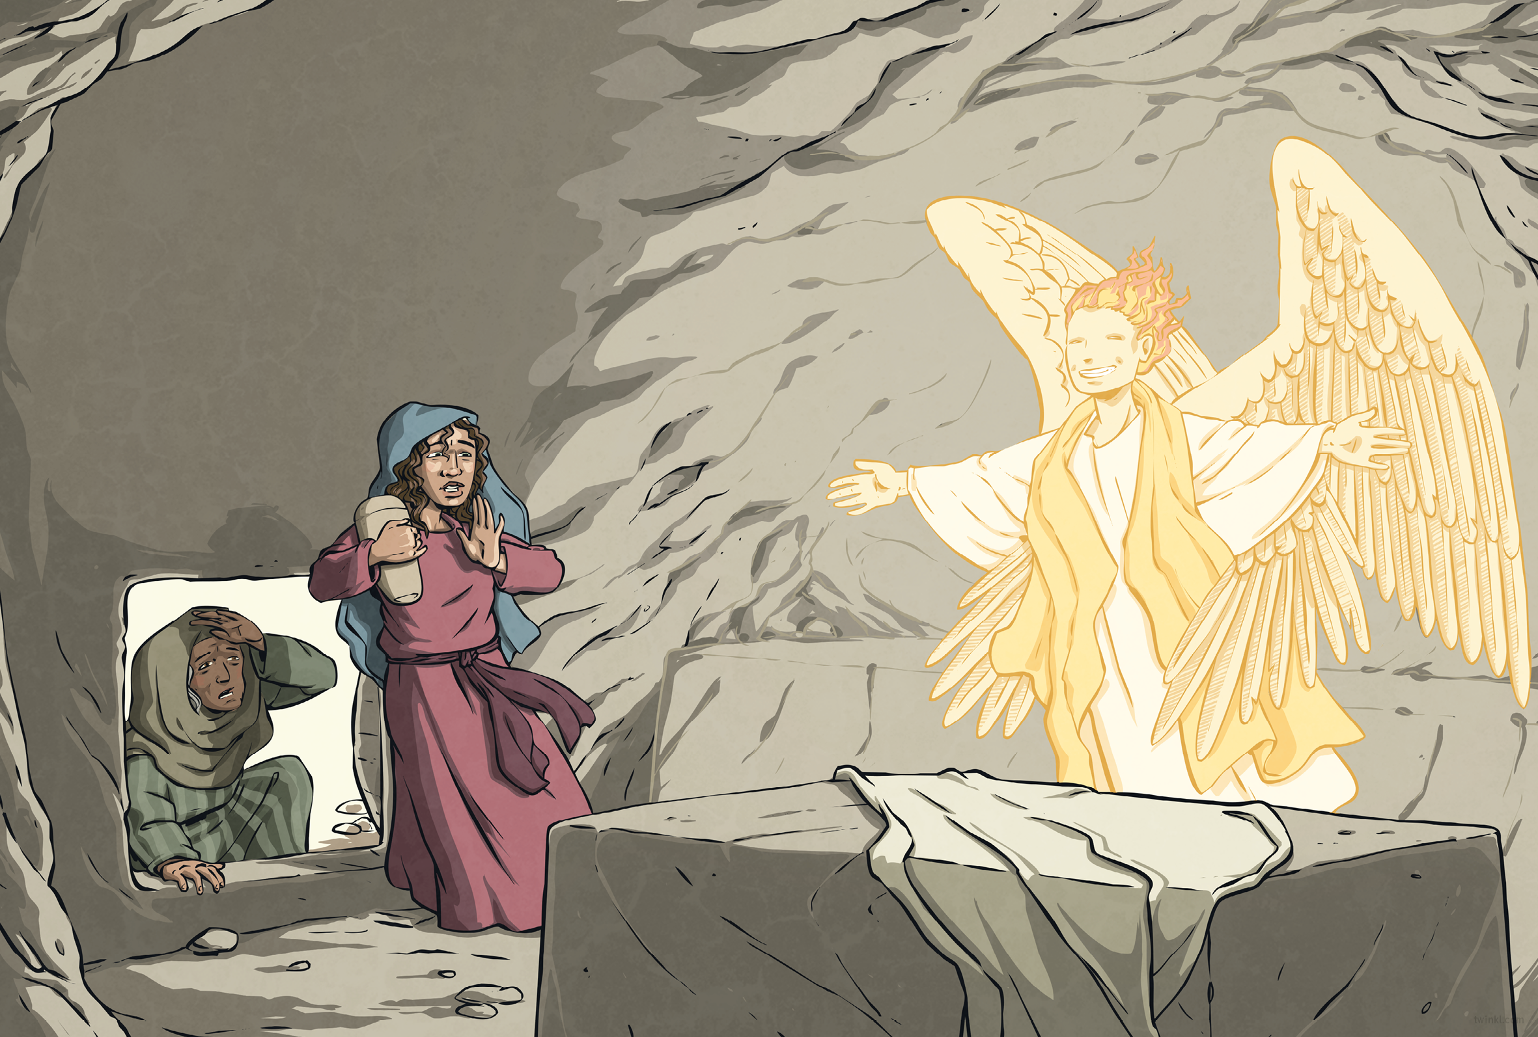
Nervously, the women stepped closer.
Inside the tomb, they saw an angel with a face like lightning and robes as white as snow.
“Don’t be afraid,” said the angel. “Jesus is not here – he has risen, as he said he would.”
The women rushed from the tomb, full of joy, to tell the disciples what they had seen and from there, the news spread all over Jerusalem.

Slide 19
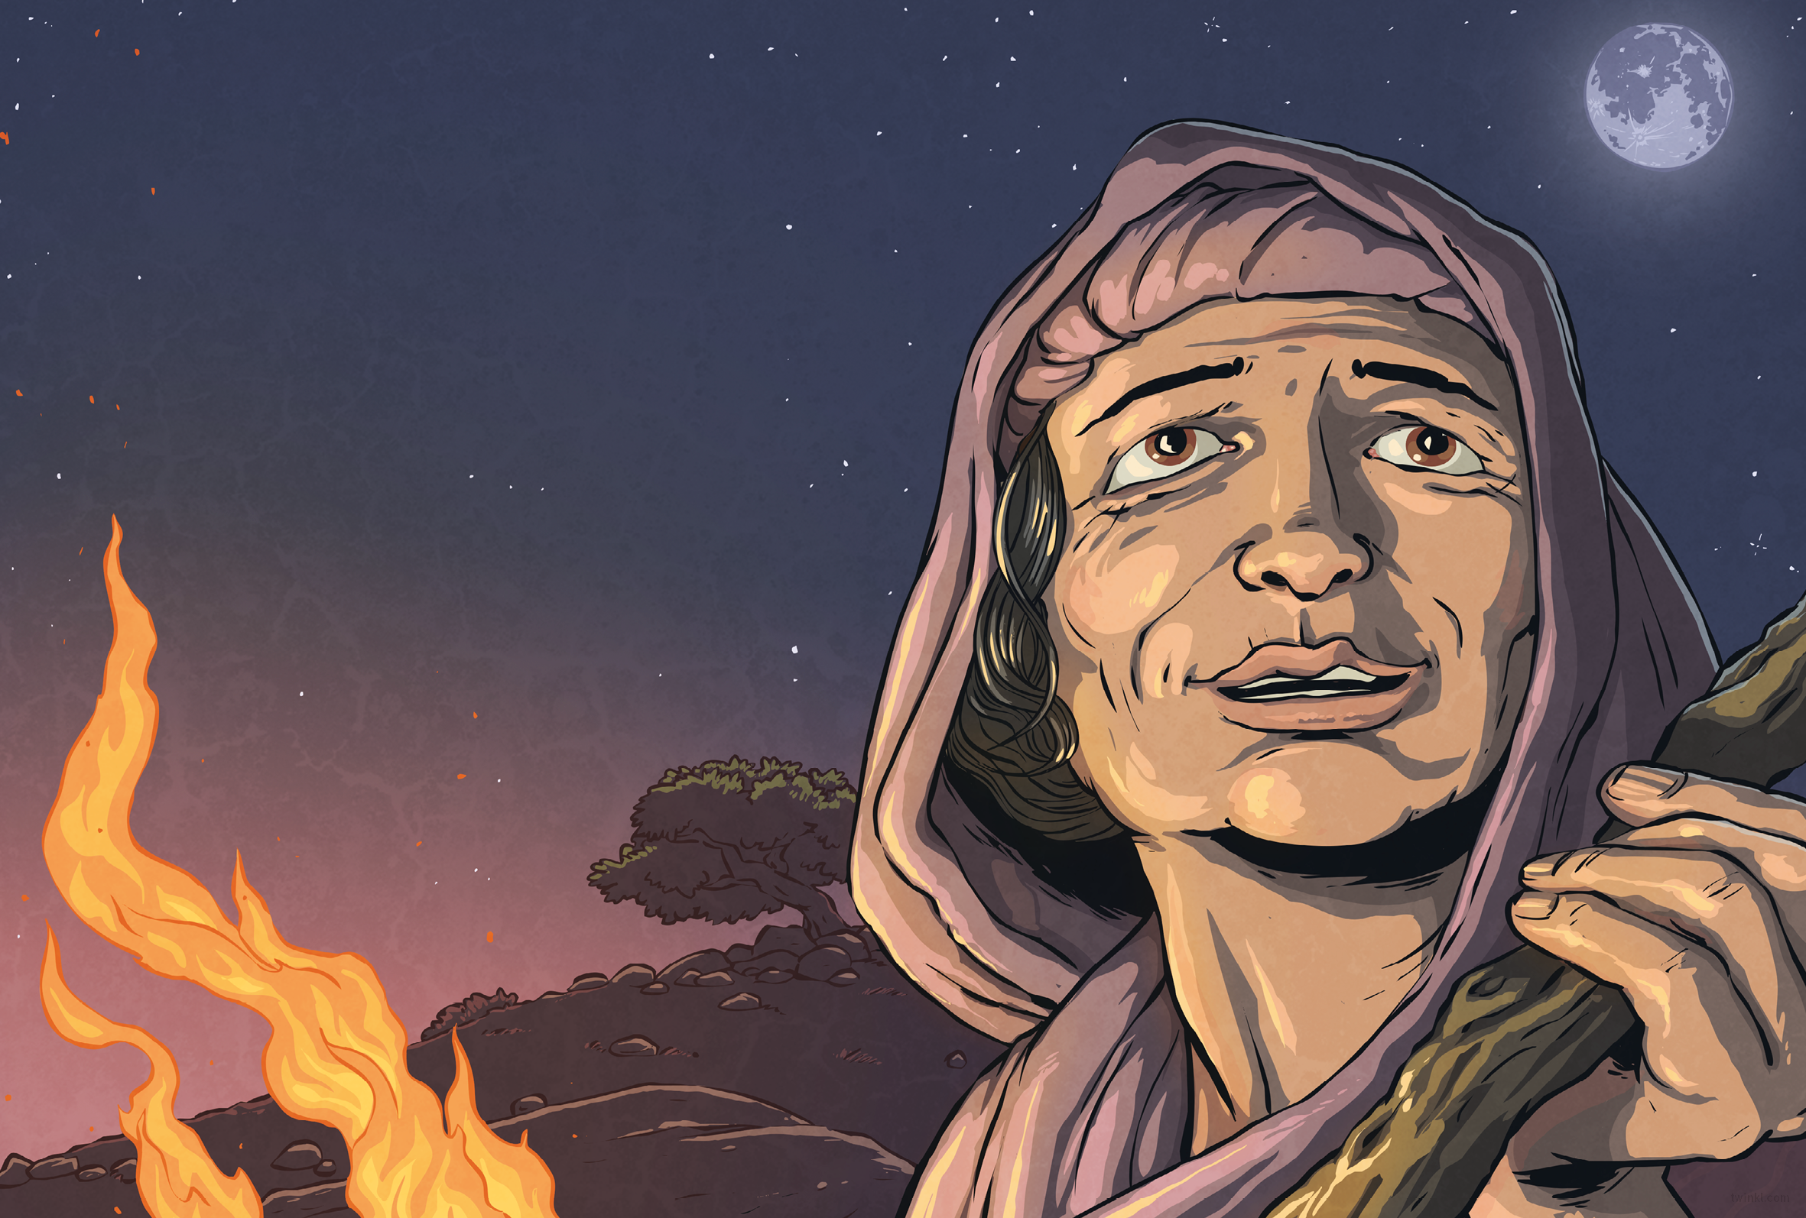
Some say that Jesus appeared to the women right there, in the garden. Some say that he met his disciples on the road to Emmaus, or on a mountain, or at a feast in Galilee. They all say that what he prophesied was fulfilled: that after he was crucified, he rose from the dead. But all that was many years ago now.
What’s that? Who do I think Jesus really was?
I think it’s a matter of faith.

Slide 21


